Slide 1
A SHORT HISTORY OF PROPERTY VALUATION MODELS
— THE 17TH TO 21ST CENTURY
Prepared for presentation at the
European Real Estate Society Conference, Stockholm, Sweden,
27 June 2009
Rodney L Jefferies
Agricultural Management and Property Studies Department,
Commerce Faculty, Lincoln University, Canterbury, New Zealand
P.O. Box 84, Lincoln University, Lincoln 7647, New Zealand

Slide 2
Overview of Paper
The aim of this paper is to set in context of a history — necessarily short to fit in the scope of a conference paper — concentrating on describing and examining the development of investment valuation models — not the theory beyond that necessary to explain the models in their historical context.
It does deal with methodology — but only to the extent as to how the models fit within the broader investment valuation paradigms of their day and professional generation.
This paper, based on the author’s PhD current research literature review, omits any equations and examples of the models referred to. The citations and references refer the reader to relevant sources for such details and elaborations by the originators of the models. (A Doctoral proposal was presented at this ERES Conference Doctoral Session 1.5 – A generic property interest real value investment valuation model).
Accompanying this paper is a colour chart [Following] setting out the key contributions to income valuation models historically over the last four centuries in chronological order by decades within each highlighted century, beginning in 1600 to the present time.
This shows the contributions of the various authors stratified into those from the UK, USA, and Australia/New Zealand with a brief identification of their key publications or contributions.
It highlights the historical developments in income valuation models set longitudinally against the different technologies available to valuers applying these models in practice.

Slide 3
Sections in Paper
Introduction
  History of income valuation thought, concepts, professional practice and standards
  Historical development of investment valuation models
  Investment versus market value
Firstly, UK property investment valuation models
  History of models and valuation tables in 16th–18th Century
  Equated yield models
  UK rational or logical valuation models
  Real value models
  RICS Research report into valuation methods
  UK Professional response and EY endorsement
  Real Value Hybrid Model
  Discounted cash flow “models” in the UK
  Advanced explicit DCF, arbitrage , split tenant-risk/market risk rate , actuarial, convertible bond and real options models
Inter-country comparisons

Slide 4
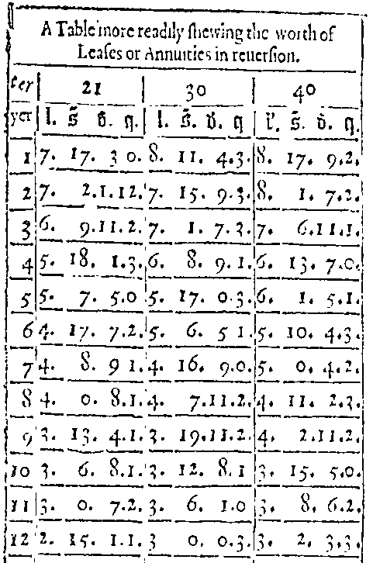
Clay’s 17th Century Valuation Model
Based on 30 years purchase @ 3.33% p.a.

Slide 5
Sections in Paper Continued
Secondly, USA investment real estate appraisal models
  Capitalization models in the USA – 1930-1960s
  Split-capitalization models
  Band of investment models
  Ellwood’s mortgage-equity model
  Discounted cash flow (DCF) models in USA
  Blackadar’s dynamic capitalization model
Thirdly, Australia & New Zealand
  Synthesis of traditional and other models from UK & USA
  Australian & New Zealand adaptations of DCFs from overseas models
  DCF model development & standards in Australia & New Zealand
  Jefferies’ generic real value model

Slide 6
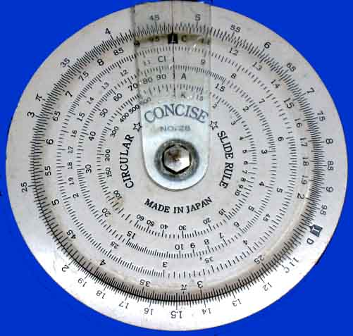
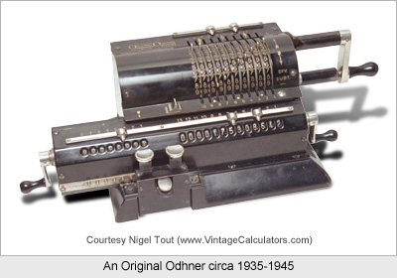
Influence of technology on progress
Author's slide rule from the 1960's
Odhner Mechanical Calculator circa 1935-45 as used by Author in Dunedin in 1964

Slide 7
Sections in Paper Continued
Fourthly, The parallel influence of technology
This first technological advance arose from the printing press – mass produced ready-reckoners, almanacs and valuation and interest tables from the early 17th Century
Next advance was the introduction of slide rules in 18th — 20th Century
Next was mechanical calculators — invented in 1822 used to 1960s
Next was electronic calculators — invented in 1957 used to present
Next was electronic computers — invented in 1960s used to present
Application of models to multi-tenanted properties
The lag in textbook coverage
“Long live” direct capitalisation!
  Progress is inevitable however!
Valediction
  This author would propose a real value model for real estate valuation
  – but “he’d have to say that” – wouldn’t he?
The time-charts Follow:

Slide 8
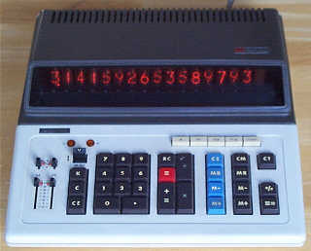
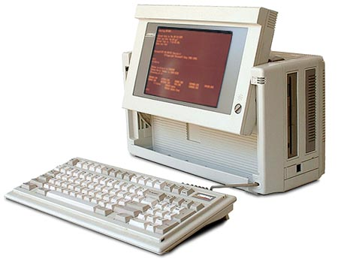
Technology becomes – electronic
& then small and portable
Vintage Compaq Portable II -1986
As used by Author 1986-1995
Vintage Sharp Compet 364R Calculator
As used by Author ex 1973 & still on his desk

Slide 9
17th – 21st Century – Development of Income Valuation Models
Chronological Overview
Don’t worry its too small - overall view - see next slide for 17th Century only!

Slide 10
17th - 19th Century – Development of Income Valuation Models - Chronological Overview

Slide 11
Chronological Overview – 17th Century

Slide 12
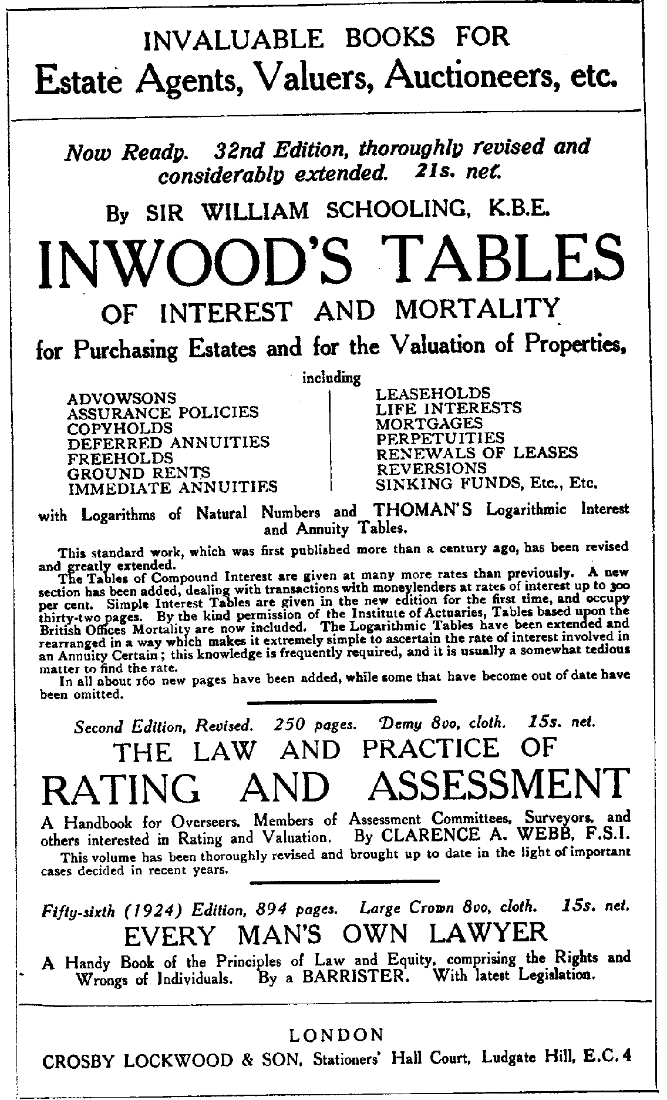

Slide 13
Chronological Overview – 18th Century

Slide 14
Chronological Overview – 19th Century

Slide 15
Chronological Overview – Early to Mid 20th Century

Slide 16
Chronological Overview – Mid 20th Century

Slide 17
Chronological Overview – Late 20th Century - 1990s

Slide 18
Chronological Overview – Beginnings of 21st Century - 2000s

