Slide 1
The Interrelationship of the media and the U.S. Housing Boom and Bust
Donald R. Haurin*
Robert Croce
Carroll Glynn
Carole Lunney

Slide 2
The U.S. housing boom & Bust
There was an unprecedented boom in the housing market during 1996 to 2006 and an unprecedented bust since 2006/7
There is general consensus that the bust is simply a correction of the boom
The boom/bust cycle was very large in the U.S. but not limited to the U.S.
There are substantial disruptions being caused by the bust. To avoid the boom-bust cycle requires understanding the causes of the boom.
The cycle occurred in both real house prices and home sales.

Slide 3
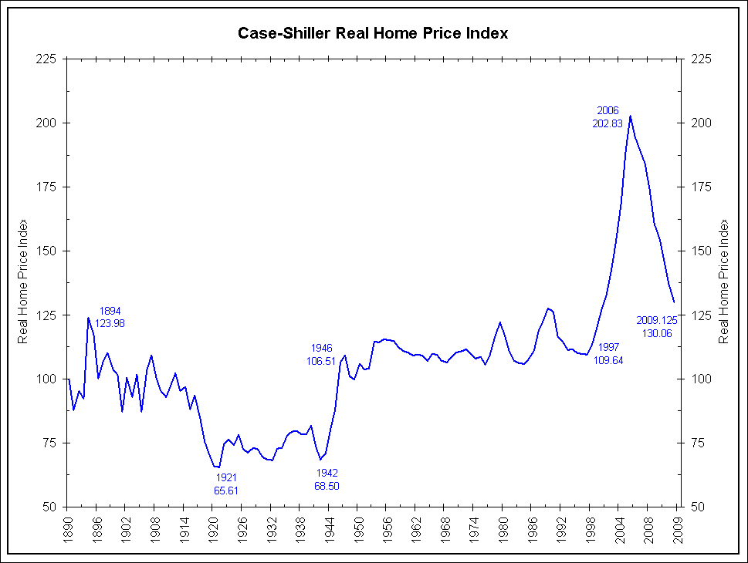
Visual Evidence for a “Bubble” in Real House Prices: 1890-2009

Slide 4
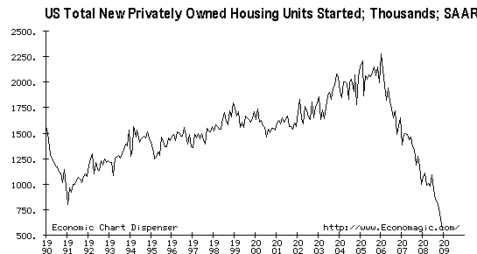
New Home construction: Boom and Crash: 1990-2009

Slide 5
Overview of the paper
Brief listing of potential causes of the boom and bust
  Possible role of house price expectations
  Possible role of the “news” media (television, internet sources, newspapers, radio)
Model and hypotheses
Literature about media influences
Granger Causality and VAR estimation results
Conclude

Slide 6
Potential Causes of the housing boom-supply side
It was not caused by an increase in the cost of producing housing (materials or labor)
An inelastic supply of housing could have contributed to the price volatility in selected (coastal) MSAs, but not in the majority of areas in the U.S.
The down payment constraint was relaxed in various ways
Risk based pricing became prevalent (subprime loans, etc.)
Mortgage brokers played a role in generating a large flow of mortgages
Appraisers appear to have systematically overvalued properties
The secondary market became very active

Slide 7
Potential Causes of the housing boom-Demand side
The demand for homeownership depends on user cost of owning relative to renting
Prob own =f(p_{h}*UC / p_{r})
UC= user cost =
  (r + t_{p}) (1 – t_{y}) + d + TC/t^{e} – π^{e}
Interest rates dropped during 2000-03, but not in 2003-06
The relative cost of owned housing to the rental cost (p_{h}/p_{r}) rose during the boom -- wrong direction of change to explain the boom

Slide 8
Causes: change in House price expectations
The remaining explanatory factor in user costs is the house price expectations term.
Perhaps it rose dramatically during the housing boom.
However, there are no good measures of house price expectations for 1996-2006
  Case-Shiller’s 2003 survey during the price boom reported unexplainably high expected house price increases in places such as Milwaukee. I found the same for 2005 survey data for Columbus, Ohio.

Slide 9
Causes: change in House price expectations
Recent data (2007-2010) from the Survey of Consumers directly measures expected house price changes
  “By about what percent do you expect prices of homes like yours in your community to go (up/down), on average, over the next 12 months?”
  Survey results
    Maximal regional deviation = only 2 percentage points
    Nominal house prices were expected to fall only modestly

Slide 10
House price expectations, by region: 2007:4 -2009:3 they are too high and too spatially uniform

Slide 11
Comparison of expected and actual house price changes
The survey’s reported expectations are too optimistic and there is too little regional variation
Data from Freddie Mac (annual growth rate)

Slide 12
Why are households’ house price expectations “inaccurate”?
Robert Shiller (2005) noted that “the history of speculative bubbles begins roughly with the advent of newspapers”. He also argued that the media amplify the attention paid to housing prices during a boom by creating a “price change-news story-price change” feedback loop.
The idea behind our hypothesis is that the national media influences the formation of local house price expectations.
Our goal is to test this hypothesis as best as possible.
  To do so we have to relate measures of media coverage of the boom and bust to observable measures of housing demand and supply.

Slide 13
One version of The model
HOUSING MARKET
MEDIA ARTICLES
PUBLIC OPINION: DEMAND AND SUPPLY OF EXISTING HOMES

Slide 14
THE Media and the economy
There is a substantial literature relating the economy, media coverage, and public opinion
  In general the studies’ findings are mixed. Sometimes the media influences public opinion (holding constant the actual events), sometimes not.
  There is a reasonable amount of evidence that the media coverage of negative news is greater than that of positive news and that negative news is more influential on public opinion than positive news.

Slide 15
Data: content analysis of the news media
Using Lexis-Nexis, we identified 1,665 articles about the U.S. housing market in USA Today between January 1996 and October 2008
We measured the overall tone of the article and each article was coded for the presence (1) or absence (0) of mentions of high home prices, low home prices, high home sales, and low home sales. We aggregated the data to a monthly index.

Slide 16
Data: Measures of demand and supply of housing (public opinion)
We used two measures of consumer sentiment about the housing market, derived from the Survey of Consumers (Reuters/University of Michigan, 2010).
  “Generally speaking, do you think now is a good time or a bad time to buy a house?” (GTTB)
  “Do you think now is a good time or a bad time to sell a house?” (GTTS, limited to current owners)
  The measures vary from 0 to 200 and vary monthly.
  In both cases reasons for the answers were given

Slide 17
The model of factors affecting GTTS and GTTB
For GTTS (the supply of existing homes) we expect variables that increase GTTS will include
  House prices being high or rising
  The volume of sales being high or rising (which implies a shorter marketing time)
  Media articles indicating the above
For GTTB (the demand for homes) we expect variables that affect GTTB will include
  Mortgage interest rate levels, house price levels, housing being viewed as a good investment (house prices will increase), and the economy’s strength
  Media articles about the above

Slide 18
The Values of housing articles’ Tone, Good Time to Buy, and Good Time to Sell

Slide 19
Reasons for Indicating it is a Good Time to Buy

Slide 20
Reasons for Indicating it is a Good Time to Sell

Slide 21
Media: articles about high and low house prices

Slide 22
Media: articles about high and low house sales

Slide 23
Econometric modelS
We use both a Granger causality model and a vector autoregressive model (VAR)
The set of endogenous variables is dictated by data availability and theoretical considerations
In the VAR model, all variables are allowed to affect each other, with some structure imposed about the temporal order of influence. Deciphering the results is typically done through impulse response functions (IFR).
  In a IRF, a variable is “shocked”(e.g. by 1 s.d.) for one period and the evolution of itself and other variables is measured. There can be no/little effect, or positive and negative effects. These effects can be transitory or persist over time (months)

Slide 24
variables
We redefine the media variables to be
  Index: Media price = media high price – media low price
  Index: Media sales = media high sales – media low sales
  Tone of the articles (5=positive, 1=negative)
  The unit of the measure is articles/month
Economy
  Mortgage interest rate and change in real income
Housing Market
  Case-Shiller real house price index
  Sales of existing and new houses
Public Opinion about the Housing Market
  GTTB
  GTTS
Periodicity = monthly data
Lags structure: used AIC to identify that up to 2 period lags were optimal. (Seems reasonable)

Slide 25
Granger model results

Slide 26
Granger model results
Pairwise Granger tests of the basic cyclic causality model suggest statistically significant effects for:
  The various media articles reflecting what is happening in the housing market (prices and sales cause media articles about prices and sales)
  For the media affecting GTTS (but not GTTB)
  For GTTS and GTTB affecting housing market outcomes (prices, existing and new home sales).
Tests of other links in the model indicate significant effects for:
  Prices cause GTTS (not GTTB)
  GTTS and GTTB cause media tone, price, and sales
  The media causes changes in observed home sales and prices (“media frenzy”)

Slide 27
VAR model impulse response functions:
Responses to a house price increase of 1 s.d.

Slide 28
Responses to increase in observed housing price
Note the 95% confidence intervals are displayed.
Results:
  The increase in house prices persists for about 5 months
  Media stories about high prices increase with a month’s lag by 0.5 to 0.8 articles
  The tone of media stories was unaffected
  A direct effect on GTTS, which rises by 3 points
  No effect on GTTB
  As expected, no effect on interest rates or income

Slide 29
Responses to a shock to media reporting of high prices by 1 s.d.

Slide 30
Responses to a shock to media stories about house prices
The “own” effect persists only for a couple of months
Media stories on high prices increase GTTS by about 2 points, but GTTB is not affected
There is a feedback effect whereby media stories about high house prices increase house prices

Slide 31
Responses to a shock to media tone by 1 s.d

Slide 32
Responses to a shock to media tone by 1 s.d
GTTB increases
GTTS increases
House prices increase

Slide 33
The effects of increasing gttb and gtts (PUBLIC OPINION)
Increasing GTTB leads to
  Media tone increases
  house prices increase
  GTTS increases
Increasing GTTS leads to
  house prices increase
  More media stories on house prices increasing
These results complete the Shiller argument of a complete feedback mechanism

Slide 34
Responses to a shock to new home sales
A persistent “own” effect for at least 10 months
Increases in
  Existing home sales
  Media tone
  Media stories about sales rising
  GTTB
  GTTS

Slide 35
Responses to a shock to media stories about high or rising hoME SALEs
New home sales rise (bandwagon type of effect) by 1% for at least 10 months
Media stories persist for 2-3 months
GTTS rises for at least 10 months
There are similar effects for a shock to media tone (and GTTB rises)
Also we find shocks to GTTB and GTTS positively affect new home sales

Slide 36
Tentative Revised model
HOUSING MARKET PRICES AND SALES
MEDIA
PUBLIC OPINION: DEMAND
AND SUPPLY OF EXISTING HOMES

Slide 37
summary
We investigate Shiller’s hypothesis that the media played a role in increasing housing demand.
We create measures of the amount and content of newspaper articles. We identify measures of public opinion about whether it is a good time to buy a house and sell a house. We use both house price and home sales to measure the state of the housing market.
There is evidence from a Granger and a VAR model that the amount and content of newspaper stories had a role in the housing boom and bust.
  The news media reported the news from the housing market
  The news media influenced public opinion on whether it was a good time to buy and sell a house
  The news media had an independent influence on the evolution of house prices and home sales.

