Slide 1
Alternative investments: the stability of the co-movements between asset classes
Keith Elliott and Gianluca Marcato

Slide 2
Introduction/Motivation
This paper assesses whether the correlations between asset classes are stable over time.
In recent times certain investors had been expanding the number of asset classes that they allocate to including ‘alternative asset classes’.
One of the main reasons used to justify the inclusion of a wider variety of asset classes in a portfolio is that they increase diversifying power.
Few previous studies have addressed if correlation is stable over time at a cross-asset class level.

Slide 3
Introduction/Motivation 2
This work is particularly relevant given the recent financial crises and its impact on the asset markets.
During the financial crises there have been comments in the press, for example:
“correlations between US equities, property, corporate bonds and hedge funds are now above 0.8”.
(Financial Times in 2009- referring to a Morgan Stanley Private Wealth Management report)
I will use data from January 1991 to June 2009, thus including the period at the heart of the financial crises and a wide range of asset classes will be studied. Two main methods will be used.

Slide 4
Literature Review 1– Stat. Tests
Both the Jennrich (1970) and Box (1949) tests:
  Kaplanis (1988) - 10 countries stock market returns
Jennrich (1970) test:
  Longin and Solnik (1995) - 7 countries’ equity returns
  Bracker and Koch (1999) - ten national stock indexes
  Eichholtz (1996) - 8 Datastream international real estate equity indices
  Schinder (2009) - 13 international FTSE EPRA/NAREIT indices
Box (1949) test:
  Lee (2006)- 10 U.K. IPD market segment indices (Box M)

Slide 5
Lit. Review 2– Semicorrelation
Erb, Harvey and Viskanta (1994)- G7 countries equity returns (MSCI). International cross-correlations are considerably higher in down-down markets than up-up markets.
Newell and Acheampong (2001)- Australian study on listed property trusts (LPTs) with both stocks and bonds.
Schindler (2009)- FTSE EPRA/NAREIT monthly indices across 13 different countries.
Gabbi (2007)- rolling semicorrelation across equity indices, both geographical areas and business sectors.

Slide 6
Data 1
Monthly log total returns from Jan 1991 to June 2009
Equities:
  Domestic: FTSE 100
  International- MSCI World ex. U.K. ($)
Fixed Income:
  Sovereign: Barclays Capital U.K. Gilt All Maturities
  Higher Credit risk: Barclays Capital Sterling Credit Ex Sov /Supra All Maturities (mostly corporate)

Slide 7
Data 2
Real Estate:
  IPD U.K. all property (both a desmoothed version and original data version for comparison is included)
  Listed property companies- FTSE/ NAREIT UK
Commodities:
  With an energy bias- S&P Goldman Sachs Commodity Index
  More balanced- Thomson Reuters/Jefferies CRB
  Gold- S&P Goldman Sachs Gold TR
Hedge Funds:
  General- HFRI Composite Index

Slide 8
Data 3- Descriptive Statistics
 | EQ | EQ_W | REIT | IPD | IPD_U | Gilts | Cred | GSCI | CRB | Gold | HFRI
Mean | 0.61% | 0.51% | 0.31% | 0.57% | 0.59% | 0.67% | 0.66% | 0.25% | 0.20% | 0.43% | 0.99%
SE | 0.28% | 0.30% | 0.45% | 0.08% | 0.27% | 0.11% | 0.11% | 0.42% | 0.25% | 0.31% | 0.14%
Median | 0.99% | 1.06% | 0.50% | 0.74% | 0.69% | 0.75% | 0.80% | 0.57% | 0.43% | -0.08% | 1.23%
SD | 4.19% | 4.43% | 6.68% | 1.15% | 4.06% | 1.57% | 1.69% | 6.27% | 3.78% | 4.67% | 2.06%
Kurtosis | 0.91 | 2.73 | 3.65 | 7.99 | 6.70 | 0.81 | 3.67 | 3.30 | 9.51 | 3.04 | 2.89
Skew | -0.70 | -1.07 | -0.16 | -2.18 | -0.69 | -0.15 | -0.84 | -0.74 | -1.38 | 0.48 | -0.76
Range | 24.19% | 31.59% | 56.66% | 8.95% | 38.80% | 10.07% | 13.49% | 51.08% | 38.12% | 37.16% | 16.35%
Min | -13.77% | -20.99% | -25.49% | -5.41% | -19.32% | -4.84% | -8.59% | -33.13% | -25.19% | -14.69% | -8.70%
Max | 10.42% | 10.60% | 31.17% | 3.54% | 19.48% | 5.23% | 4.89% | 17.95% | 12.93% | 22.47% | 7.65%
J-B (5%) | 24.63* | 106.94* | 116.78* | 733.4* | 411.1* | 6.26* | 143.08* | 114.2* | 864.09* | 88.67* | 93.33*
J-B (10%) | 24.63* | 106.94* | 116.78* | 733.4* | 411.1* | 6.26 | 143.08* | 114.2* | 864.09* | 88.67* | 93.33*

Slide 9
Data 4- Overall Correlations
 | EQ | EQ_W | REIT | IPD | IPD_U | Gilts | Cred | GSCI | CRB | Gold | HFRI
EQ | 1.00
EQ_W | 0.77 | 1.00
REIT | 0.25 | 0.28 | 1.00
IPD | 0.15 | 0.22 | 0.33 | 1.00
IPD_U | 0.10 | 0.11 | 0.29 | 0.47 | 1.00
Gilts | 0.18 | 0.01 | -0.03 | -0.17 | -0.14 | 1.00
Cred | 0.42 | 0.26 | 0.16 | 0.08 | 0.11 | 0.77 | 1.00
GSCI | 0.16 | 0.26 | 0.16 | 0.20 | 0.07 | -0.08 | 0.10 | 1.00
CRB | 0.24 | 0.39 | 0.21 | 0.24 | 0.17 | -0.12 | 0.12 | 0.80 | 1.00
Gold | -0.22 | -0.12 | -0.05 | -0.04 | 0.00 | 0.07 | 0.07 | -0.01 | -0.02 | 1.00
HFRI | 0.64 | 0.75 | 0.26 | 0.19 | 0.19 | 0.02 | 0.30 | 0.34 | 0.42 | -0.04 | 1.00

Slide 10
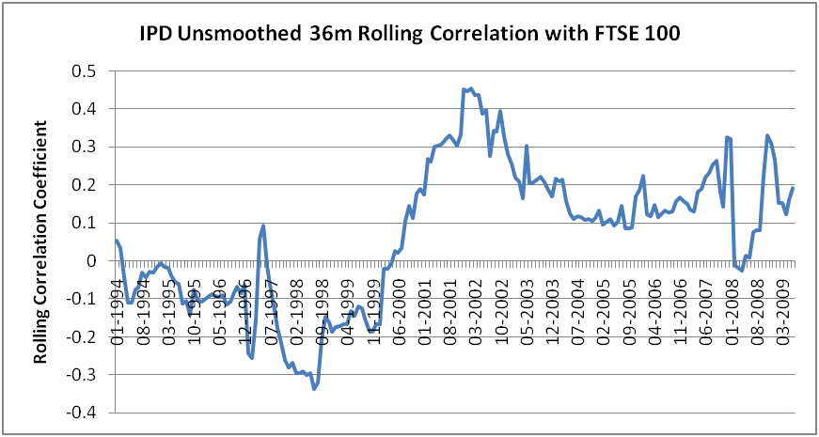
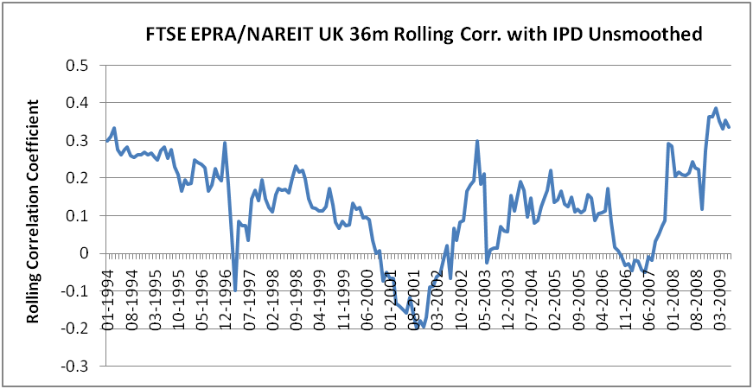
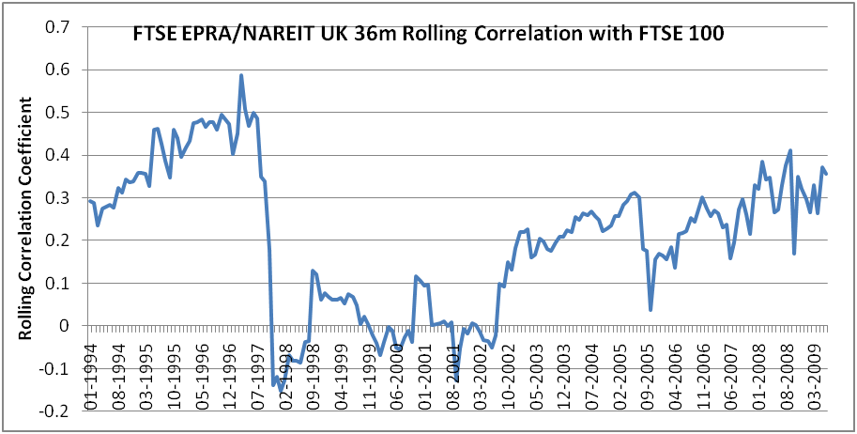
Rolling Correlations
The rolling correlations show a wide range of coefficients over time.
May appear to have low mean correlations. Although SD and range may be high.
However; we have to cautious when interpreting rolling correlations.

Slide 11



Model 1- Statistical Tests
Jennrich (1970)- correlation and covariance matrices. Chi-squared distributed.
Box M (1949)- mainly used for covariance matrices but can also be adapted for correlation Can use Chi-squared or F statistic.
In order to perform the tests I split the data chronologically into 4 equal groups of 4 years and 7 months (55 months), not using the last 2 months.

Slide 12


Model 2- Semicorrelation
Semicorrelation is a method of calculating the correlation of returns in different market states.
The ex-post returns are separated between above and below average (i.e. up and down), leading to measurement of correlation in 3 possible states: up-up, down-down and out of phase.
Statistically there is no reason why the returns above the means should have different correlations to those below the mean.
Positive semicorrelation:
where:

Slide 13
Results 1- Statistical Testing
Stability of Correlation and Covariance Matrices:
Periods Compared:
 |  | Correlation |  | Covariance
Periods Compared |  | Jennrich | Box | Jennrich | Box
First | Second | Chi-square | Chi-square | Chi-square | Chi-square
A | B | 50.88 | 132.21** | 157.04*** | 192.00***
B | C | 52 | 94.37* | 105.91*** | 109.23***
C | D | 94.91*** | 174.09*** | 236.33*** | 374.89***
A | C | 61.37 | 222.30*** | 209.02*** | 273.74***
A | D | 74** | 300.56*** | 219.02*** | 334.53***
B | D | 69* | 180.45*** | 224.28*** | 364.32***
A | B | C | D
Jan 91 to July 95 | Aug 95 to Feb 00 | March 00 to Sept 04 | Oct 04 to April 09

Slide 14
Results 2- Semicorrelation
UP-UP State
Table shows the differences between semi-correlation in down-down states minus up-up states
DOWN-DOWN State
 | EQ | EQ_W | REIT | IPD | IPD_U | Gilts | Cred | GSCI | CRB | Gold | HFRI
EQ | 1.00
EQ_W | 0.51 | 1.00
REIT | 0.24 | 0.32 | 1.00
IPD | 0.06 | -0.02 | 0.22 | 1.00
IPD_U | 0.06 | 0.03 | 0.08 | 0.83 | 1.00
Gilts | 0.35 | 0.15 | 0.34 | 0.20 | 0.12 | 1.00
Cred | 0.36 | 0.24 | 0.33 | 0.26 | 0.12 | 0.71 | 1.00
GSCI | -0.10 | 0.15 | -0.09 | -0.17 | 0.02 | -0.15 | -0.05 | 1.00
CRB | -0.12 | 0.02 | -0.11 | -0.09 | 0.06 | -0.20 | 0.16 | 0.61 | 1.00
Gold | 0.04 | 0.04 | -0.18 | 0.02 | 0.12 | -0.02 | -0.01 | 0.01 | 0.35 | 1.00
HFRI | 0.31 | 0.39 | 0.09 | 0.07 | -0.02 | 0.02 | 0.09 | 0.18 | -0.04 | 0.12 | 1.00
 | EQ | EQ_W | REIT | IPD | IPD_U | Gilts | Cred | GSCI | CRB | Gold | HFRI
EQ | 1.00
EQ_W | 0.75 | 1.00
REIT | 0.28 | 0.51 | 1.00
IPD | 0.33 | 0.50 | 0.65 | 1.00
IPD_U | 0.22 | 0.36 | 0.43 | 0.77 | 1.00
Gilts | 0.04 | -0.10 | -0.14 | 0.13 | -0.11 | 1.00
Cred | 0.46 | 0.40 | 0.27 | 0.51 | 0.30 | 0.59 | 1.00
GSCI | 0.28 | 0.53 | 0.56 | 0.60 | 0.51 | -0.18 | 0.27 | 1.00
CRB | 0.52 | 0.63 | 0.59 | 0.62 | 0.54 | -0.04 | 0.52 | 0.81 | 1.00
Gold | 0.12 | 0.14 | 0.42 | 0.65 | 0.57 | -0.12 | 0.27 | 0.41 | 0.51 | 1.00
HFRI | 0.51 | 0.68 | 0.36 | 0.40 | 0.32 | -0.24 | 0.40 | 0.38 | 0.62 | 0.16 | 1.00
 | EQ | EQ_W | REIT | IPD | IPD_U | Gilts | Cred | GSCI | CRB | Gold | HFRI
EQ | 1.00
EQ_W | 0.24 | 1.00
REIT | 0.04 | 0.19 | 1.00
IPD | 0.27 | 0.52 | 0.43 | 1.00
IPD_U | 0.16 | 0.33 | 0.35 | -0.06 | 1.00
Gilts | -0.31 | -0.25 | -0.48 | -0.07 | -0.24 | 1.00
Cred | 0.10 | 0.16 | -0.06 | 0.26 | 0.18 | -0.12 | 1.00
GSCI | 0.38 | 0.38 | 0.65 | 0.77 | 0.49 | 0.03 | 0.32 | 1.00
CRB | 0.64 | 0.61 | 0.70 | 0.71 | 0.48 | -0.16 | 0.37 | 0.21 | 1.00
Gold | 0.08 | 0.10 | 0.60 | 0.63 | 0.45 | 0.11 | 0.28 | 0.40 | 0.16 | 1.00
HFRI | 0.19 | 0.30 | 0.26 | 0.33 | 0.34 | -0.26 | 0.31 | 0.20 | 0.66 | 0.04 | 1.000
Also run on a 36 month rolling basis; here results are not as strong:
Large positive differences for correlations involving the FTSE 100, The MSCI World, FTSE EPRA NAREIT and the R/J- CRB.
Negative differences with Gilts and Gold. Some negative with Credit / IPD.

Slide 15
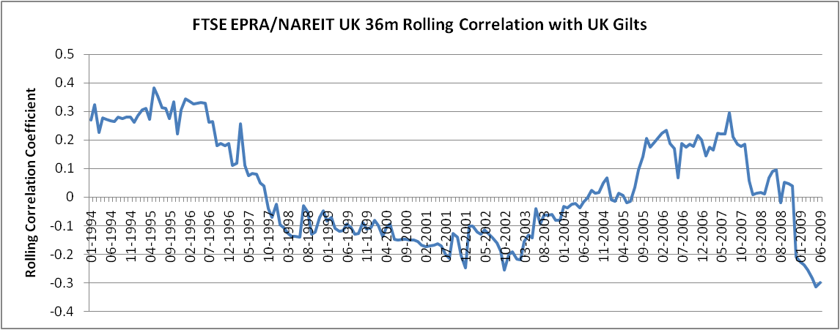
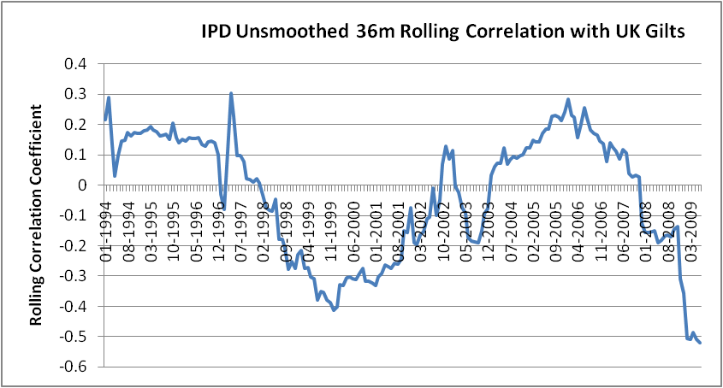
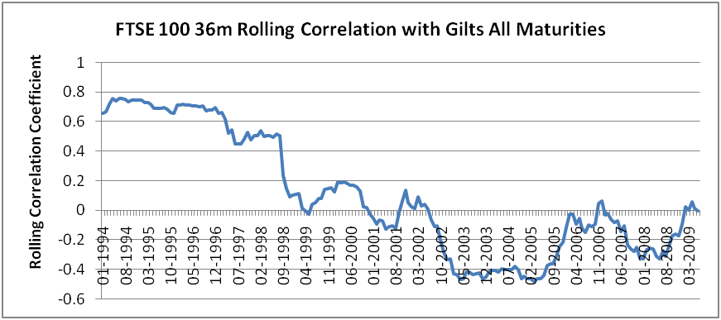
Rolling Correlations With Gilts
Semicorrelation has shown us that Gilts may be the key diversifying asset.
Correlations tend to be negative around times of economic stress.
This may be due to sovereign debt’s role as a ‘non-risk’ asset and ‘flight to safety’ effects.

Slide 16
Conclusions
This study has firstly proven that the correlations between a number of different asset class proxies are not stable over time.
Statistical testing find that the correlation matrix was frequency unstable and the covariance matrix was always so.
Following on from this the study proves, using semicorrelation, that in most cases that correlations tend to increase in down markets.
Highlights the important role of sovereign debt within a portfolio.
‘Alternative' assets correlations increase in down markets thus they fail to provide protection when they are needed the most.

Slide 17
Further Research
Add statistical testing of each of the individual correlation coefficients within the matrix as in Lee (2006).
To look at the stability of correlations using a DCC- GARCH type framework.
Leading on to second area of what are the drivers of the correlations between asset classes? (do certain macro variables affect this change over time):
  Regressions using rolling correlations
  Adapt Goldstein and Nelling (1999) for a macro variable
  Factor DCC

Slide 18
Thank you

