Slide 1
Effect of Housing Supply Control Strategy
Huang, Yi Kun The University of Hong Kong
Wang, Xiao Cen McGill University
Chau, Kwong Wing The University of Hong Kong

Slide 2
Introduction
Control of housing supply is a possible strategy for real estate developers.
Is this strategy available? How does it work? Any evidence?

Slide 3
Introduction
The fundament of our research is the demand and supply in Neoclassical Economics.
Demand Side
Demand of houses can be divided as consumption need and investment need.
Investment needs normally increase in house price rising market, thus can be seemed as a general form of speculation. (Malpezzi and Wachter, 2002)
Supply Side
Oligopoly: a few powerful developers in this market, and they can easily control the housing supply

Slide 4
Literature Review
1) Oligopoly in Real Estate
Real estate developers often operate in oligopolistic environment in reality (Ong, et al, 2003)
Grenadier (2005) also used a special case of the option exercise game framework to explore a continuous-time Nash Equilibrium which bases on oligopolistic real estate market.
Wu and Li (2007) also points out that the market structure can cause the supply to be controlled by a few powerful developers that may manipulate the supply of houses.
2) Supply control
Objective reasons: land use restriction; environmental regulation
Subjective reasons: profit, enterprise strategy

Slide 5
3) Speculative demand
Many researchers have observed that speculation in land or in real estate market is prime factor that drives house price cycle. (Atterhog, 1995; Feagin, 1982; Malpezzi & Wachter, 2002)
Phenomenon: higher demand accompanies with increasing house price.

Slide 6
Model Development
Assumptions I: Normal consumption demand exists before the supply control strategy; and the speculative demand is 0 this time. When supply of houses was control to a sufficiently low level, speculative demand will be aroused. ( )
Assumption II: Normal consumption demand will not be affected by supply control strategy. That means the demand curve of this customers group will not shift after the supply control.

Slide 7
Without Supply Control
Reversive Demand Function:
Total Revenue:
Total Cost:
Maximum Profit:

Slide 8
Under Supply Control
Speculative Demand: when
Total Demand:
Profit Function:
Inequalities System for supply control Strategy:

Slide 9
Condition for supply control strategy (Inequalities system has solution)
[ , ]
The left hand side is the Control Interval.
this condition can also be expressed as:
and .

Slide 10
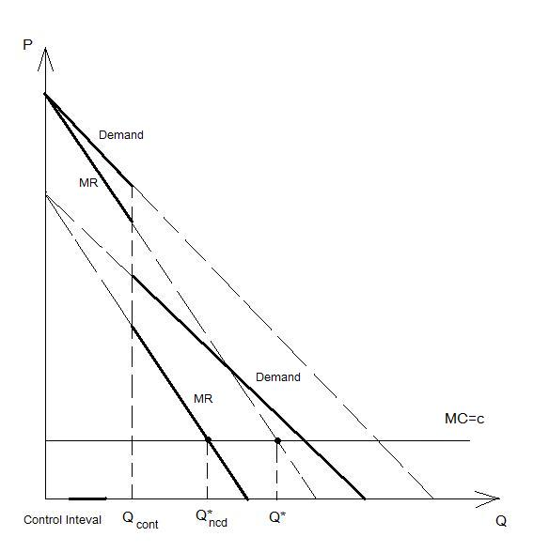
Marginal Inequality for Optimization
Assumption (Completely Raised Demand): after applying supply control, new demand of houses merely shift upward in first quadrant (including Q-axis and P-axis).
Equivalent:

Slide 11
Empirical Study for Supply Control Strategy
The mechanism of supply control strategy is that housing developers provide a supply control signal (for both subjective and objective reasons) to arouse speculative demand; and achieve higher profit.
The housing market data of Hong Kong were collected from Census and Statistics Department of Hong Kong for empirical study.
Housing Supply: # of newly completed private residential buildings
House Price: House price index (benchmark at 1999)
Developers Profit: Gross Domestic Capital Value (at current market price) from private building and construction sector

Slide 12
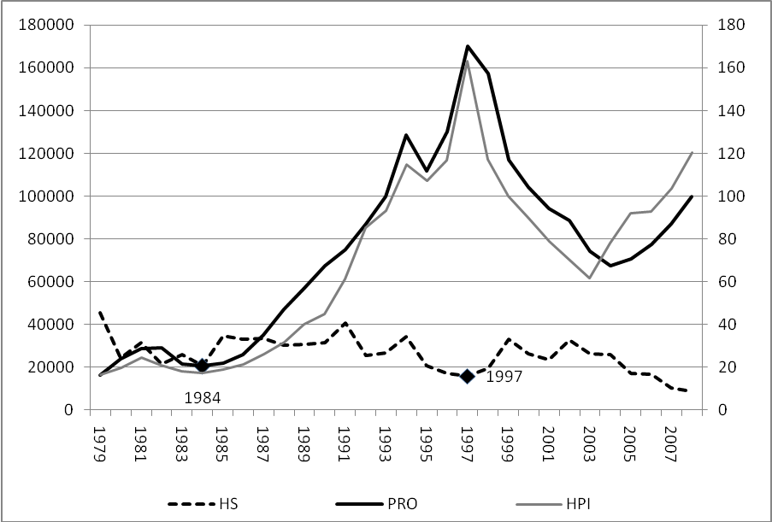
Period for Supply Control: 1984 to 1997 (The Sino-British Joint Declaration)

Slide 13
Model:
Vector autoregressive (VAR) regression for exploring the dynamic relation.
Criterion for Model Selection:
AICc for relatively small sample size
Selection result: k=1 for VAR model.

Slide 14
Effect of Supply Control Strategy
With
Null Hypothesis:
: ( is the coefficient for HS in PRO equation when D= i )

Slide 15
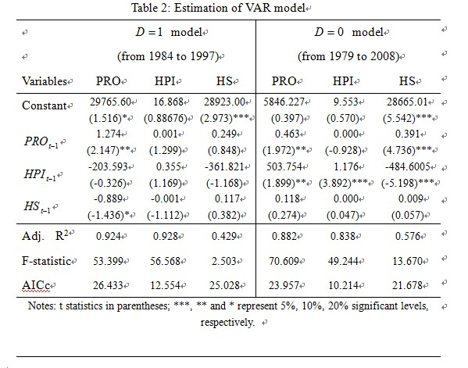
Result for VAR
Null Hypothesis has been rejected.

Slide 16
Summary and Conclusion
1) In this paper, we explore the mechanism of supply control strategy and set up a model to explain it. By analyzing the profit change, we found out the Conditions for supply control strategy and the Interval of it.
2) Under the assumption of Completely Raised Demand, we also prove the marginal inequality when real estate developers maximize their porfits.

Slide 17
3) By applying VAR model, we used the data of Hong Kong from 1979 to 2008 to verify that supply control strategy can successfully help developers achieve excessive profit.
Thank you!

