Slide 1
Mortgage Constraints: Implications for UK Housing Markets
17th Annual ERES Conference Milano June 2010
Martin Haran
Michael McCord
David McIlhatton
University of Ulster

Slide 2
Introduction
Residential Mortgages -Epicentre of GFC
Financial De-regulation
Enhanced Accessibility to Mortgage Finance
Expansion in Mortgage Product

Slide 3
An Expanded Mortgage Market
Enhanced Efficiency through Competiveness
Growth in UK Sub-prime Lending
Financial Stimulus to Overheated Market
Stability of UK Mortgage Market Post-GFC

Slide 4
Methodological Application
Methodological Application
Content Analysis of Literature
Statistical Evaluation
Key Stakeholder Interviews
Analytical Modelling of Outcomes
Findings Dissemination

Slide 5
Number of Loans & House Prices (UK)

Slide 6
Number of Loans & House Prices (NI)

Slide 7
Separation of House Price to Income

Slide 8
Detachment of Lending and Income ratio

Slide 9
Relaxation in Lending Standards

Slide 10
Loan-to-Value

Slide 11
LTV & The Cost of Borrowing

Slide 12
PROPERTY AQUISITION BY VALUATION (FIRST-TIME BUYERS)

Slide 13
PROPERTY AQUISITION BY VALUATION (HOME MOVERS)

Slide 14
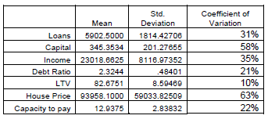
Preliminary Analysis

Slide 15
Analytical Modelling
Where: K is equal to capital (Value of Loans)
Y is equal to income
D represents the level of debt income multiple
LTV is the loan-to-value at time t
HP represents house price
C is the capacity to service interest payments

Slide 16
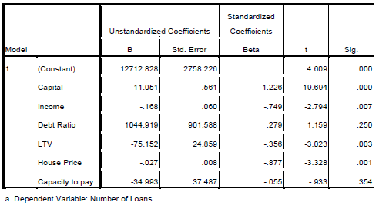
Model Analysis
ANOVA (89.70, p <.005)
M_{AVAIL} = 12712.82β₀ +11.05β₁ - 0.168β₂ – 75.15β₃ – 0.027β₄

Slide 17
Conclusions
Contraction in risk appetite
Current inflexibility in lending decisions
Wholesale removal of 100% LTV Products
Turbulent period of realignment (Lag), economic (macro & micro) balance
The panacea of financial and economic uncertainty will create ongoing discord.

