Slide 1


Do Peer Effects Shape Residential Values?
Reconciling the Sales Comparison Approach with Hedonic Price Modelling
François Des Rosiers, Laval University, Canada
Jean Dubé, INRS-UCS, Canada
Marius Thériault, Laval University, Canada
Paper presented at the 17th ERES Annual Conference,
Milan, Italy, June23 -26, 2010
Research partly funded by

Slide 2
Objective and Context of Research
Although the hedonic framework can be said to vary substantially from the traditional sales comparison approach both are derived from a similar paradigm with respect to how market values, are determined.
This paper aims at reconciling the two approaches by integrating peer effects in the hedonic equation, a concept developed, and mainly used, by labour economists.
The ensuing model accounts for three types of effects, namely endogenous interactions effects (i.e. comparable sales influences, or peer effects), exogenous, or neighbourhood, effects and, finally, spatial autocorrelation effects.

Slide 3
Literature Review and Conceptual Grounds
Peer effects, which can be defined as the influence that members of a group exert on a given individual in the group, have long been mentioned in the literature (Leibenstein, 1950; Veblen, 1899).
Game theory: Asch (1956) and by Becker and Becker (1998) emphasize the role of social interactions with respect to the individual choice process.
Labour economics: the publication, in 1966, of the Coleman report (Coleman et al., 1966) on student performances sparked off this new paradigm.
Manski (1993) seminal contribution: three factors lead individual behaviour within a group: (i) endogenous interactions; (ii) exogenous interactions; and (iii) correlated effects.

Slide 4
Literature Review and Conceptual Grounds
Endogenous interactions: any individual in the group is affected by the average behaviour of the group.
Exogenous, or contextual, interactions: influence exerted on individuals by the socio-economic profile of group members.
Correlated, or latent, effects stem from non-observable environmental attributes that apply to all group members and which can be brought forward as an explanation for the presence of SA in the model residuals.
Impact of peers on:
  individual productivity at work (Ichino and Maggi, 2000) ;
  school performances (Hallinan and Sørensen, 1983; Sacerdote, 2001; Zimmerman, 2003)

Slide 5
Literature Review and Conceptual Grounds
  Social interaction models have been applied to the new social economy (Durlauf and Young, 2001) and for modelling urban housing markets (Meen and Meen, 2003).
  Peer Effect Model:
  where: Y_{ig} = dependent variable for individual i in group g;
  Y_{g} , = endogenous variable for the group and parameter;
  X_{ki} , β₁ = property attributes and parameter;
  X_{g} , β₂ = exogenous (or contextual) attributes and parameter
  Endogeneity problem handled: Y_{g} expressed, for any given submarket, as the mean sale price of houses for the previous quarter, with property i sale price being excluded from the computation.

Slide 6
The Database
Canadian database provided by the former Quebec Urban Community (CUQ) Assessment Division on some 15,729 single-family detached houses sold between January 1990 and December 1996, with prices ranging from $50,000 (Can.) to $250,000.
The database contains reliable information on sale prices and major property attributes (building type and age, living area and lot size, interior quality descriptors, presence of specific features); access to local water and sewerage systems as well as local tax rate are also accounted for.
Model also controls for time trend (year dummies), access to local and regional services as well as socio-economic and household structure dimensions.

Slide 7
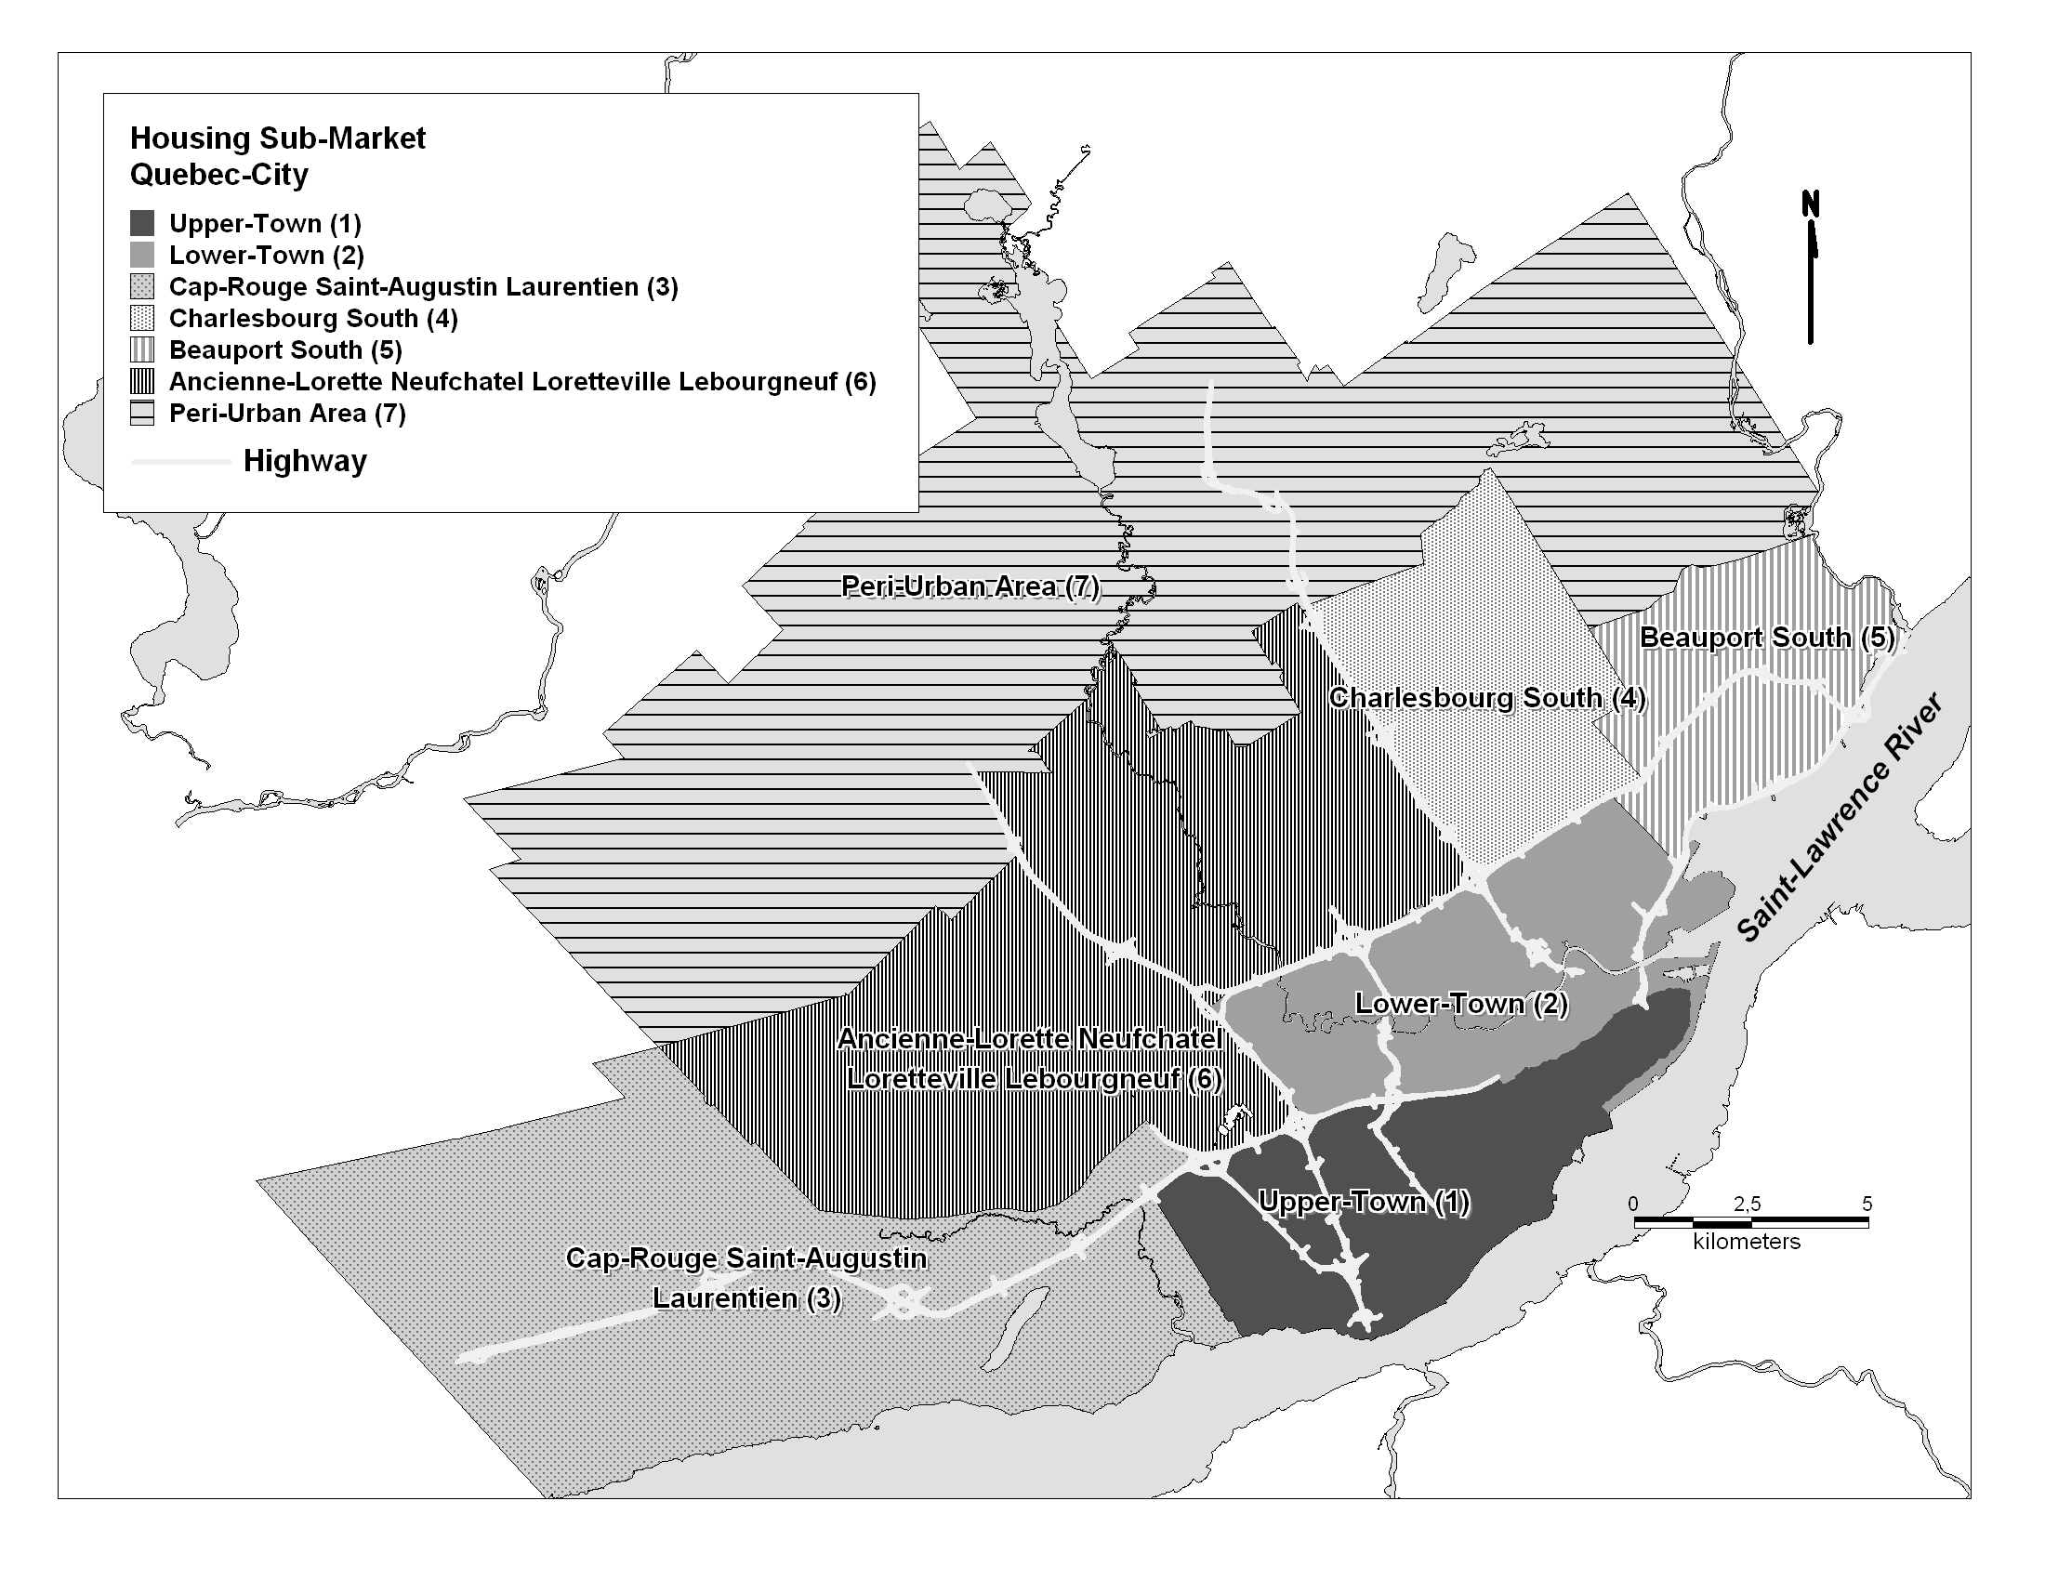
Submarket Delimitation (discriminant analysis)

Slide 8
Main regression Findings – OLS Method
A semi-log functional form is used, with liveable area, building age and lot size also being applied a logarithmic transformation.
Four different specifications are used (Table 3):
  The first specification (Base Model,) only includes property structural and land attributes as well as time dummies;
  In the second specification, exogenous, or neighbourhood, influences are added to the Base Model;
  Endogenous effects are substituted to the latter in the third specification (Peer Effect Model);
  Finally, the fourth specification yields the Global Model which incorporates both exogenous and endogenous effects.

Slide 9
Main regression Findings – OLS Method

Slide 10
Main regression Findings – SAR-Err Method

Slide 11
Main regression Findings – SAR-Err Method
A SAR-Spatial Error procedure clearly yields improved overall performances when compared with the OLS method – all the more so for the Base Model specification which generates a 0.77 R-Squared.
As expected, the Lambda parameter (in excess of 0.97) is highly significant) as the SAR procedure proves most efficient at solving SA problems, at least to a large extent.
Thus, even with the first specification, the Moran’s I value drops from 0.1486 (OLS) to a mere 0.0092 (SAR); with the Global Model, it is down to 0.0006 and only significant at the 0.05 level.

Slide 12
Main regression Findings – SAR-Err Method
Secondly, controlling for spatial dependence results in regression parameters displaying a much greater stability throughout the spectrum of housing characteristics, even for attributes whose coefficients tend to exhibit pronounced variability under the OLS procedure.
This is particularly the case with the local tax rate attribute and with time dummies.
The constant term, finally, is also favourably affected by adopting a SAR procedure, as reflected in its lessened fluctuations among model specifications.

Slide 13
Main regression Findings – SAR-Err Method
Last but not least, regression findings obtained with the SAR procedure corroborate the usefulness of the endogenous effect variable in the hedonic price function, even where spatial dependence is controlled for.
Indeed, under the Peer Effect Model specification, its parameter reaches 0.3839 (p < 0.001) and remains highly significant, although with a lower magnitude (0.2623), even after the inclusion of contextual determinants.
Accounting for peer effects also contributes to lowering SA in the residuals, as suggested by the sharp drop in the Moran’s I value, from 0.0039 (Base Model + Exogenous effects) to 0.0006 (Global Model).

Slide 14
Conclusion and Suggestions for Further Research
Findings suggest that peer, endogenous, effects do act as significant determinants of property values and that, when used in combination with exogenous attributes in the hedonic price equation, they prove quite effective at reducing the extent of spatial dependence in the model residuals.
Furthermore, even where a spatial autoregressive procedure is applied so as to explicitly account for spatial autocorrelation influences, the peer effect variable parameter still emerges as being highly significant and contributes to lessen SA still further.

Slide 15
Conclusion and Suggestions for Further Research
Such findings lead to the conclusion that the comparable sales approach, as used in traditional appraisal practice, is a valid one, although its application is typically flawed by the too small sample size generally used by appraisers.
The peer effect model allows revisiting the conformity principle which grounds the comparable sales approach, although within the more structured and rigorous framework of the hedonic price method.
Further investigation is still needed in order to find out which submarket delineation should be used to obtain optimal model performances.

