Slide 1



ERES 2011 Eindhoven, June 17
Linkages between real estate markets, monetary policy and financial markets
Ranoua Bouchouicha
Zied Ftiti
Université Lumière Lyon 2
GATE-Lyon-St Etienne
CNRS UMR 5824
Notes:
This is a work in progress with Zied ftiti, today I am going to present just the results that we found through the linkages between the monetary policy and the real estate markets

Slide 2
Introduction
Agenda
  Introduction
  Motivation
  Methodology
  Data
  Results
  Conclusion

Slide 3
Introduction Motivation Methodology Data Results Conclusion oooooooooo
Introduction
Collapses in Real Estate at the heart of many financial crises
Leamer (2007), Reinhart and Rogoff (2009), Iacoviello and Neri, 2008)
Boom and busts in real estate markets an issue of concern for policy makers.
Mishkin (2007), Ingves (2007)
Housing market and the macroeconomy:
Ahearne et al.(2005), Iacoviello (2005), Case et al. (2005), Iacoviello and Neri (2008) and Vargas-Silva (2008a,b,), Gupta et al. (2010) , Bjørnland, and Jacobsen (2010)
Commercial markets and the macroeconomy:
Ling and Naranjo (1997) ), Brooks and Talascos (1999), Schätz and Sebastian (2009), Brooks and Talascos (1999)
REITs market and the macroeconomy :
McCue and Kling (1994), Ewing and Payne (2005), Bredin et al. (2011), Bredin et al.(2007)
A joint study of the 3 sectors and the macroeconomy : Hoesli et al. (2008)
Notes:
Real estate crisis can have major consequences on the economy since many studies found that collapses in house prices for example are at the heart of many financial crises (Leamer (2007), Reinhart and Rogoff (2009),Iacoviello and Neri, 2008) .
2) Thus the boom and busts in real estate markets have been an issue of concern for policy makers. In fact, the central banks and the IMF studied the impact that the monetary policy can have on the residential sector specially.
The Sweden’s central bank consider the real estate prices when it makes a real interest rate decision, adjusting monetary policy to face a rapid increases in house prices (Ingves 2007).
3) But in the literature, we dealt with the each sector seperately, there is few works that had a joint suty of the three sectors

Slide 4
Introduction Motivation Methodology Data Results Conclusion oooooooooo
Introduction
Motivation
  Mixed conclusions about the linkages of the real estate markets and the macroeconomy.
  Importance of the magnitude of the macroeconomic impact on the different real estate
  markets.
  To bring together the direct real estate market, the indirect real estate market and
  macroeconomic and risk factors.
  Time varying measure of the dependence between real estate markets and macroeconomic environment.
Notes:
2) Deviating from the majority of the studies, this study brings together the direct real estate market and the indirect real estate market taking into account the influence of some macroeconomic and risk factors.
3) Apply a time varying measure of dependence between the real estate markets in the UK and the US and their relative macroeconomic environment. Co-spectral analysis for the co-movements.

Slide 5
Introduction Motivation Methodology Data Results Conclusion oooooooooo
Methodology
Co-movements : Coherence function
The coherence function (Priestley and Tong, 1973)
Long run: Unrestricted VAR approach
Short run: Generalized impulse response
(Pesaran and Shin (1998) Koop et al. (1996))
Not sensitive to the ordering of the variables in the VAR.
Notes:
*There is 3 steps in the study: the first step is to identify if there is a comovment in a frequency domain between the real estate markets and the key macroeconomic variables.
The second step is to study the Long run linkage through the VAR model and finally the short run linkage through the impulse responses.
Coherence function: …. no future information is used, implied or required as in band-pass or trend projection methods
The equation is the ratio between the joint cospectral density function between the two serie and the non non joint distribution of each serie , it gives us the the linear relationship between corresponding components at frequency w in the processes {Y (t)} and {X(t)}.
*With the purpose of measuring the interaction between economic variables and their degrees of convergence, we use some notions
such as co-movement. The notion co-movement, coherence and cohesion function are frequencies functions. Why we use this domain and not a time
domain.

Slide 6
Introduction Motivation Methodology Data Results Conclusion oooooooooo
Data
Real estate data | Macroeconomic data
UK Residential : Halifax price index Securitized market : DataStream REITs index Commercial : IPD index US Residential : S&P/CS National price index Securitized market : DataStream REITs index Commercial : NCREIF index | 10 years Government bond yield LIBOR 3 months Money supply M2 Growth rate Expected and unexpected inflation
Q1:1991 to Q4:2010
Notes:
10 years Government bond yield as a proxy for the long term interest rate, the LIBOR 3 months for the short term interest rate, money supply M2, the growth rate, the expected and the unexpected inflation and they are in real

Slide 7
Introduction Motivation Methodology Data Results Conclusion oooooooooo
US - Coherence functions Short term interest rate

Slide 8
Introduction Motivation Methodology Data Results Conclusion oooooooooo
Long run : VAR results
All the real estate markets in the UK and the US significant to the long term interest rate except the residential real estate market in the UK dependent to the short term interest rate.
Only the residential market in the UK dependant with a negative coefficient to the money supply
The US real estate market more significant negatively to the economic growth, however for the UK, only the securitized market significant to the economic growth variations and has a positive coeff. in the first lag but a negative coeff. one in the second lag.
The residential market in UK and US more sensitive to the unexpected component of the inflation however the commercial market more sensitive to the expected component.
Notes:
in the long run all the real estate markets in the UK and the US are significant to the long term interest rate except the residential real estate market in the UK which dependent to the short term interest rate. This is explained by the fact that mortgages in the UK are mainly based on short term interest rates; however, the majority of mortgages in the US are based on long term interest rate (Borio (1995))
3) This means that in when the economic condition is not favourable, the investors in the US are attracted to the real estate sector (Hoesli et al.2008), however in the UK, the REITs investors are not attracted when the shoc occur initially but can invest in the REIT after one quarter.

Slide 9
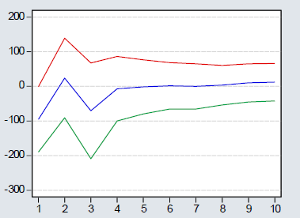
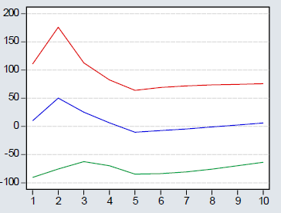
Introduction Motivation Methodology Data Results Conclusion oooooooooo
Short run
UK
Response of the REITs index to a shock in the Long term interest rate
Response of the REITs index to a shock in the short term interest rate
Notes:
The UK securitized market responds by an immediate fall to a shock in the long interest rates, but the shock produces a small cycle in REITs movements but the effect dies out after four quarter. However a shock in the short term interest rate has an immediate rise in the securitized UK market but the effect disappear after our quarters approximately
A shock in the short interest rates in the UK has a better impact in the securitized market than a shock in the long term interest rates.

Slide 10
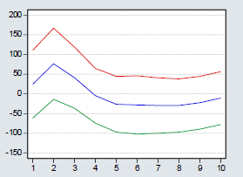
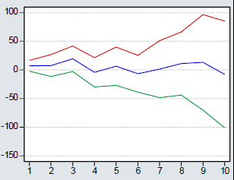
Introduction Motivation Methodology Data Results Conclusion oooooooooo
Short run
UK US
Response of the REITs index to a shock in the growth rate
Response of the REITs index to a shock in the growth rate
Notes:
the magnitude of the response of the REITs market in the UK to an economic growth is more important than in the US.

Slide 11
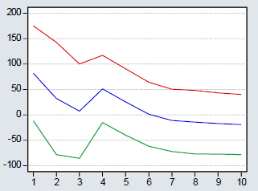
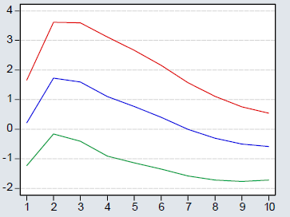
Introduction Motivation Methodology Data Results Conclusion oooooooooo
Short run
UK
Response of the REITs index to a shock in the expected inflation
Response of the house index to a shock in the expected inflation
Notes:
The UK residential market has a very significant and positive response to a shock in the expected inflation and the securitized market has a positive response to a shock in the expected inflation but disappear in six quarters. While a shock in the expected inflation has more dynamic impact on the US residential market and the REITs market.

Slide 12
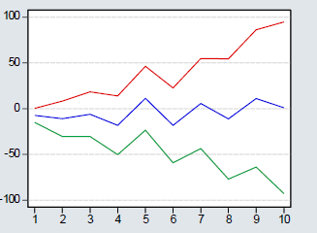
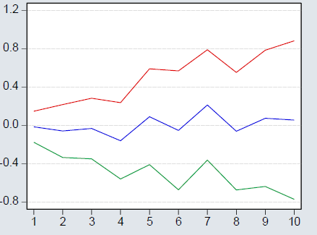
Introduction Motivation Methodology Data Results Conclusion oooooooooo
Short run
US
Response of the REITs index to a shock in the expected inflation
Response of the house prices to a shock in the expected inflation

Slide 13
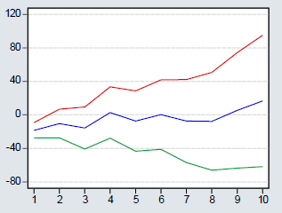
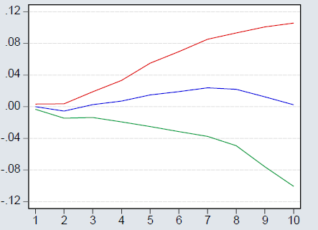
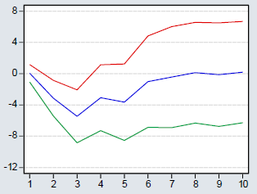
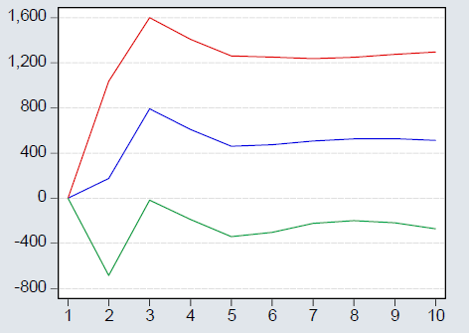
Introduction Motivation Methodology Data Results Conclusion oooooooooo
Short run
UK REITs to money supply
IPD to money supply Halifax to money supply
NCREIF to money supply
Notes:
A shock in the money supply has a negative response from the UK residential market, We find a positive response for 5 quarters from the commercial real estate market ( but disappear after 5 quarters), and a positive response for 2 quarters for the REITs.

Slide 14
Introduction Motivation Methodology Data Results Conclusion ooooooooooo
Conclusion
Co-spectral analysis:
UK : Close values in long term –short term co-movements
US : Long term co-movements more important
In the UK, the economy responds more to the real estate markets shocks ( the growth rate) however in the US economy is only affected by the residential market
Empirical evidence that in a larger economy, disturbance in Real estate markets had less effects.
➔ Targeting Real estate prices is more relevant in a small economy

Slide 15
Thank you !

Slide 16
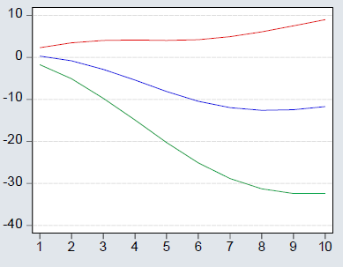
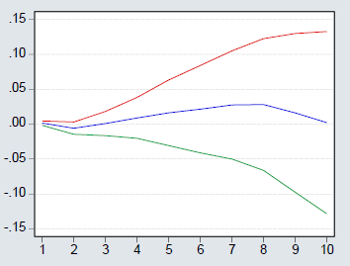
Introduction Motivation Methodology Data Results Conclusion oooooooooo
Short run
UK US
Response of IPD index to a shock
in short term interest rate
Response of NCREIF index to a shock in short term interest rate in
Notes:
The long run approve this, The commercial market in the US responds to a shock in the short interest rate by a increase after two quarters and this increase last for six quarters however for the UK, the commercial market falls immediately after two quarters

Slide 17
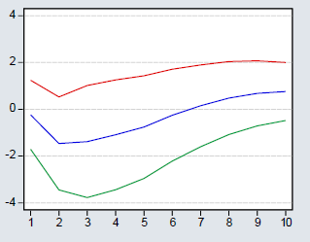
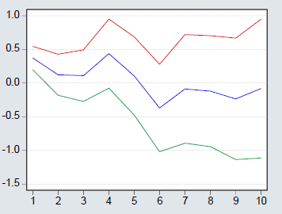
Introduction Motivation Methodology Data Results Conclusion oooooooooo
Short run
UK US
Response of Halifax index to a shock in the long term interest rate
Response of S&P/CS index to a shock in the long term interest rate
Notes:
The residential market in the UK respond negatively to a shock in the long and short term interest rate, however the residential market in the US responds positively only to the short term interest rate.
US and the money supply: only the commercial market has a small positive response to a shock in the money supply.

