Slide 1
Managing risk in residential portfolios
An instrument for the benchmarking of risk for real estate investors and social housing associations
Rob Courtens
Bert Teuben
Maarten Broek
Eindhoven, June 17th 2011

Slide 2
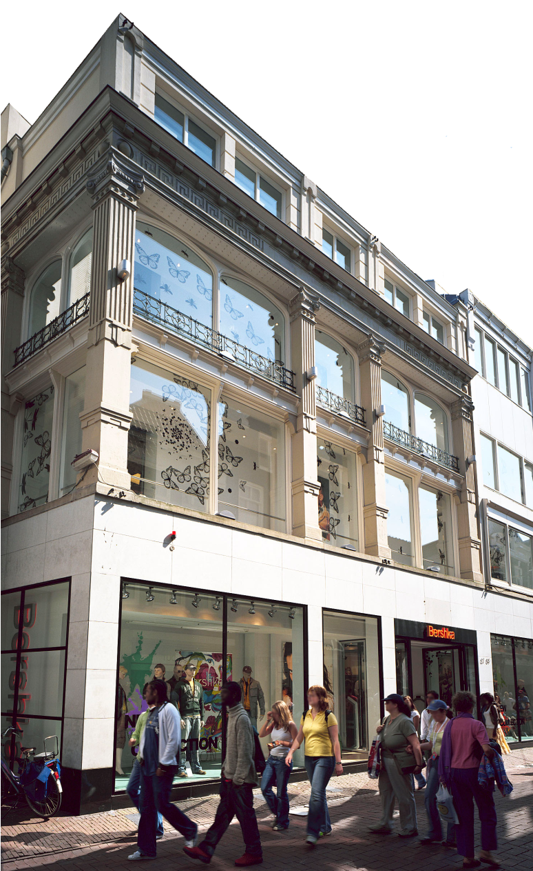
Agenda
Introduction
The Blundell risk dimensions
Suitability for Dutch residential market
  Top down
  Bottom up
  Parameters and Ranking
  Towards the Risk Web
  Ambition/ Further research

Slide 3
Introduction
Investors point of view
Return is reward for risk
Risk based on volatility lacks diagnostic content
Risk based on volatility of past returns is backward looking
(Blundell et. al., 2005)
What causes volatility in portfolio returns?
Total return = income return + capital growth

Slide 4
Blundell Risk dimensions

Slide 5
Introduction
Also for Dutch residential investment market
What is the Dutch market????
€ 197 billion market size
€ 110 billion in residential (75 % private)
€ 19 billion in IPD/ROZ residential universe
But also: The Dutch social housing market
€ 243 billion market size (market value)
€ 66 billion in IPD/aeDex universe

Slide 6
Suitablility for dutch residential market
Top Down
Dimension | Suitable to dutch investment market? | Suitable to residential market seperately? | Data available at IPD Netherlands?
Sector balance score | Yes | No | Yes
Income return | Yes | Yes | Yes
Location concentration | Yes | Yes | Yes
Development exposure | Yes | Yes | Yes
Asset concentration | Yes | Yes | Yes
Lease Length | Yes | No* | No*
TICCS stress score | Yes | Yes | No
Tenant concentration | Yes | No | No
Weighted Beta | Yes | Yes | Yes
Void Rate | Yes | Yes | Yes
* Data not relevant for residential market

Slide 7
Suitablility for dutch residential market
Bottom Up
Identifying risk dimensions for Dutch market
IVBN report
IPD/ROZ questionnaire:

Slide 8
Parameter and ranking
Concentration of rental value
Development exposure
Asset concentration
Over-rented part of portfolio
Location concentration
Turnover rate
Energy efficiency
Portfolio age
Weighted Beta
Vacancy Rate
Commercial: No interesting outcomes
Social: No interesting outcomes
Commercial: concentration of assets in 5 regions
Social: same as commercial
Commercial: Turnover rate (valuation)
Social: same as commercial
Commercial: Bad energy label or no label
Social: Not enough data yet
Commercial: Concentration 1945-1980
Social: Concentration 1945-1974
Commercial: Volatility of invested segments
Social: same as commercial
Commercial: Based on % market rental value
Social: same as commercial
Commercial: concentration > €1.000/ month
Social: % gap to maximized legal rent
Commercial: Sale income
Social: Total transformation
Commercial: concentration 5 highest value props
Social: same as commercial

Slide 9
Towards the Risk Web

Slide 10
Ambition?
Prediction of tracking error
Quick and dirty research on volatility
No statistically significant conclusions yet !
Underlying parameters of dimensions should be discussed
More long term average research
Play around with segmentations
Timing of risk (correlation)
Limitative set of definitions (with predictive use)

Slide 11
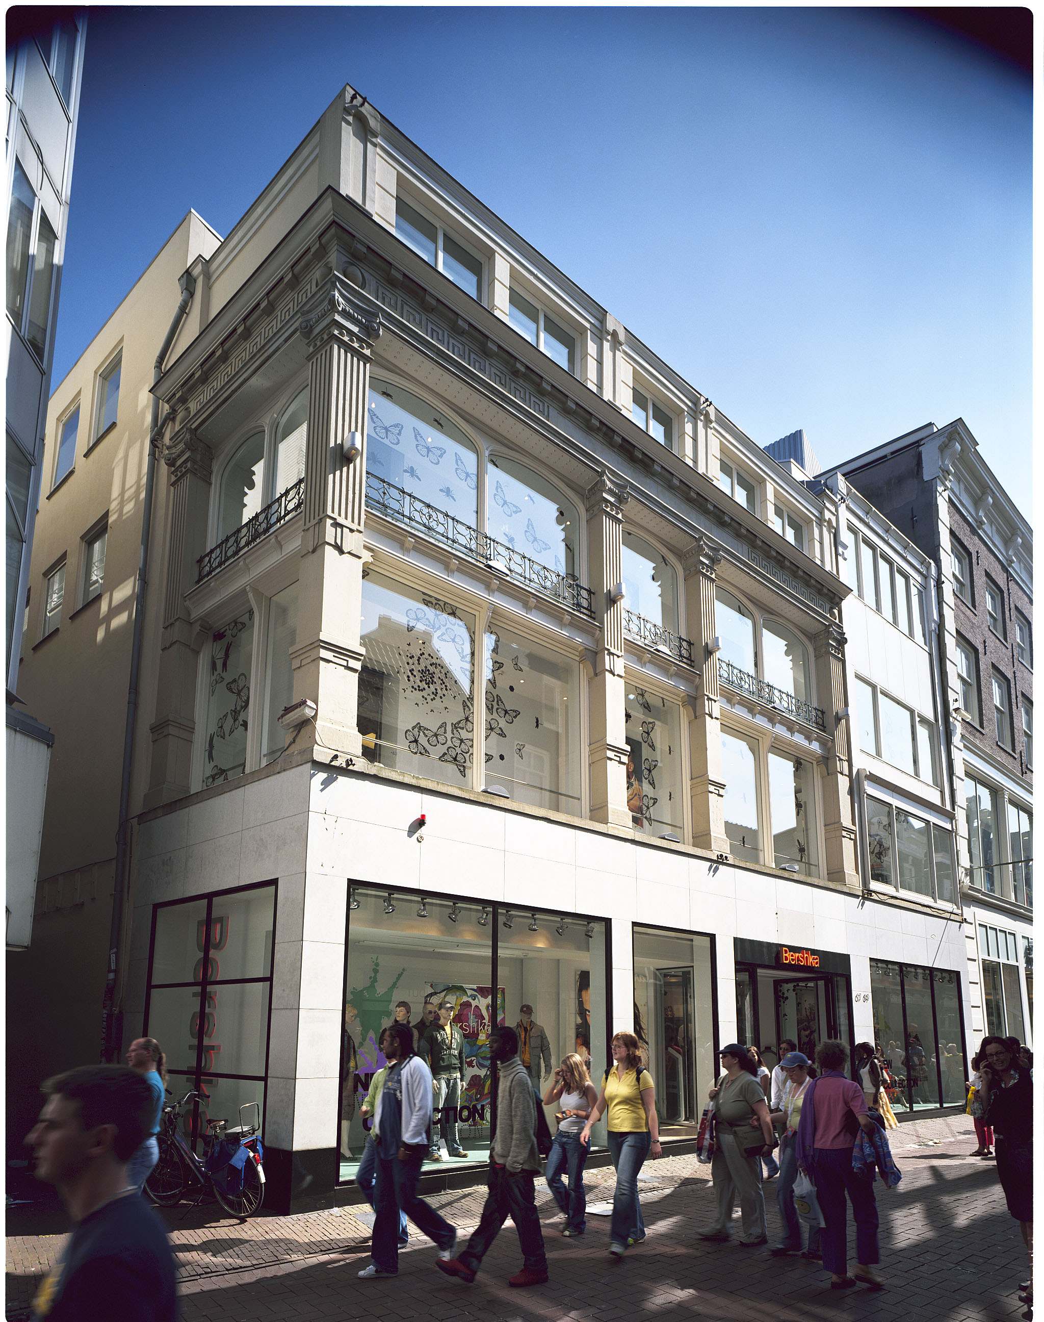

Thank you for your attention!
IPD Nederland
Busplein 30
1315 KV Almere
Nederland
Tel: +31 88 328 2200
Fax:+31 88 328 2201
www.ipd.com/netherlands
Intellectual Property Rights and use of IPD statistics as benchmarks
Whether in the public domain or otherwise, IPD's statistics are the intellectual property of Investment Property Databank Limited.
It is not permissible to use data drawn from this presentation as benchmarks.
© Investment Property Databank Limited (IPD) 2011. Database Right, Investment Property Databank Limited (IPD) 2011.
All rights conferred by law of copyright and by virtue of international conventions are reserved by IPD
Notes:
Any questions?
Provides contact details for IPD
11

