Slide 1
Integrating research into teaching using constructive alignment
Experience with two cohorts of students in a postgraduate Real Estate program
Samuel Azasu
Björn Beggren
KTH Stockholm

Slide 2
Structure
Problem statement
Importance of problem
Method and results
Discussion and issues of further research

Slide 3
Research problem
Many studies highlight the need for skilled graduates
Integration of technical competence with business skills (Butler, Guntermann & Wolverton, 1998)
The European challenge, a case study of business skill integration (Nunnington & Eilander, 2005)
Writing across the curriculum in real estate curricula (Gibler, 2001)
Using writing as a vehicle to integrate research into curriculum an additional way of exploring skill integration challenge
Using constructive alignment (Biggs, 1999)

Slide 4
Importance of problem
Integrating research and writing could enhance preparation for and quality of dissertations
-avoid plagiarism, for example
Improving preparation for dissertation could increase completion rates and prevent dropouts
Research and writing skills are transferable

Slide 5
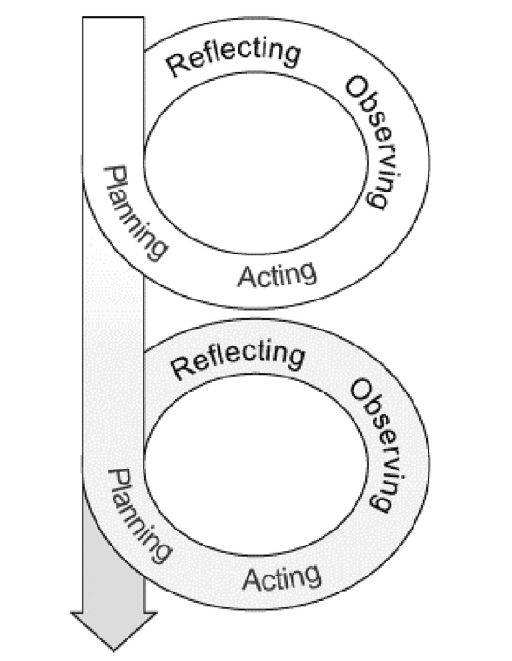
Method (Kemmis & McTaggart, 2005)

Slide 6
Primary conceptual framework
Constructive alignment (Biggs, 1999)
Recognizes difference between students who adopt “deep” and “surface” approaches to learning
Consistent relationship between objectives, activities and assessment
Goal is to get potential “surface” learners to behave like “deep” learners

Slide 7
question
What would an aligned course look like if we want to use writing as a vehicle for deep introduction to research in the field?

Slide 8
Structure of curriculum
Year 1
Quantitative methods
Portfolio Management
Urban & Reg. Economics
Real Estate Valuation
Year 1
Facilities Management
Real Estate Market Analysis
Year 2
Advanced Issues in RE Mgmt.
Review paper
Year 2
Research Methods
Research proposal
Dissertation

Slide 9
Inherited design (conventional)
Guest lectures/
Reading assignments
Lectures (Introduction)
Paper presentation
Paper proposals and
feedback
Notes:
This is the conventional way most courses are designed in many universities.

Slide 10
Analysis of design
Lectures are the least effective form of teaching most academic skills (Crouch & Mazur, 2002; Deslauriers, Schelew & Wieman, 2011)
One way information delivery
No deep understanding of discipline
Poor performance for unmotivated students
First time students cannot easily access advanced topics using lectures only
For writing assignments, no required delivery of intermediate inputs increases risk of plagiarized papers (Caroll, 2002) and papers written in a hurry
Assessment excludes process (hidden curriculum)

Slide 11
Proposed solution
Create an aligned course that allows deep learning of possible researchable area and learn to write in the process

Slide 12
goals
Deep learning of researchable topics
Deep learning of writing skills
First step towards preparation for dissertation

Slide 13
Activities
Deep learning of possible research areas
Deep learning of writing skills
Seminars on selected topics by senior teachers
Assigned reading in advance
Group discussion
Presentation in seminar
Student’s own review paper
Write a review paper using the following steps
Information search
Critical analysis of sources
Reading and note taking
Analyzing structure of a research paper
Developing outline
Peer review of sample student papers
Drafting, peer review and
Final paper submission

Slide 14
Activities
Seminars on research topics
Written exam
Workshops /exercises on different parts of writing process
Paper presentation
Assessment
Literature list
Written exam
Reading notes
Outline
Draft and peer review

Slide 15
Assessment principles (Caroll, 2002; Gibbs and Simpson, 2004)
Capture student time and attention
Direct students to progressively deeper levels of learning
Signal what is important
Assess the extent of goal achievement
Prevent plagiarism

Slide 16
Assessment (year 1)
Deep learning of possible research areas
Deep learning of writing skills
Final paper
Literature list
Reading notes
Paper outline
Draft, teacher feedback and
Final paper

Slide 17
Assessment (year 2)
Deep learning of possible research areas
Deep learning of writing skills
Seminar participation
Final paper
Literature list
Reading notes
Paper outline
Peer review of sample student papers
Draft, peer review and
Final paper

Slide 18
Student experience
Year 1
Year 2
“The design of the course is not clear... [we have been] wasting time on writing”.
“I would never be a researcher... I think most of my classmates think this is a useless course”.
It has made me a good writer and improved my reviewing skills”.
“When I began the course, I thought I had writing skills. Having taken the course, I learnt what I knew was very little ... I was [...]impressed by the level of professionalism that goes into a paper. Every single detail determines the quality of a paper and I was very fortunate to learn all about this in this course”.
“take the [reading notes] seriously because it makes your writing easy and helps avoid plagiarism”.

Slide 19
Lessons learned
Students overestimate writing skills
Research integration process must be cumulative
Start in earlier courses
Introductory courses
Content courses
Research method course
Rules of assessment matter for
Paper quality
Plagiarism
Participation in seminars and knowledge of researchable issues
Introduction to advanced research topics using lectures alone is ineffective
If earlier courses use mostly lectures, an aligned course stresses out students
sudden increase in workload

Slide 20
Ongoing research
What is the impact on quality of dissertations?
What is the impact on completion rates?
How many students undertake PhD studies afterwards?

