Slide 1
Reading Real Estate Foundation
Supporting Real Estate and Planning Education at the University of Reading

Slide 2
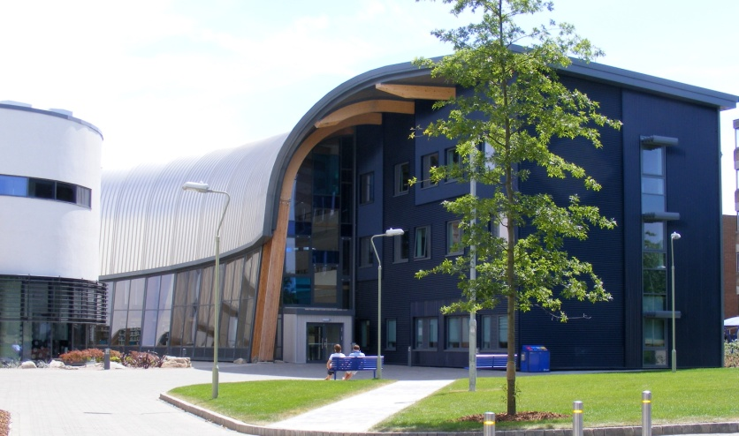
Introduction
Registered Educational Charity, established in 2002
Aims and Objectives:
  to help support and develop the quality of real estate education at the University of Reading
  maintain Reading’s position at the forefront
  of the Real Estate industry
  strengthen the links between
  the Real Estate & Planning
  and its graduates through an
  active and engaged Alumni
  Association

Slide 3
Our structure
Directors & Trustees from the industry
Sue Clayton, Executive Director Capital Markets, CB Richard Ellis
Alan Froggatt, Principal, Touchstone Advisers
Charles Graham, Principal, Europa Capital Partners
Bryan Laxton, CEO UK, Cushman & Wakefield
Stephen Musgrave, Ex-Managing Director, Hines UK
The RREF team:
Nicole Gillham - Executive Director
Gill Kemp - Events & Alumni Relations Manager
Emma Pryke – Student & Alumni Relations Assistant

Slide 4
















Corporate Patrons 2011

Slide 5
Our Supporters
Founders
We have 45 donors whose early gifts enabled RREF to become established and grow
Pioneers
There are currently 18 RREF Pioneers giving £1,000 or more each year
Friends of RREF
60 alumni give a regular monthly amount of up to £500 per year
Notes:
NG – We are delighted to have so many of our alumni donors and Corporate Patrons here this evening. Without the enthusiasm (and importantly, the gifts!) of our Founder donors RREF would not exist. They enabled RREF to become an established charity with a structured calendar of events and student support activities.
More recently we have built on this level of giving and have a growing number of RREF Pioneers, part of the University’s Pioneer programme.
Another very valuable group of alumni are the Friends of RREF whose regular donations help to build a fund that offers support in a number of ways to current students, including the Hardship Fund.

Slide 6
Our Supporters
The Appeal in 2007/8 raised funds to support the School of Real Estate & Planning and the new Henley Business School building
SEGRO – sponsored this lecture theatre and a seminar room
CBRE – Funded the Chair in Real Estate Finance and Fellow in Real Estate
Hines - Gerald D Hines Visiting Fellow in Development
ALDAR Properties - Professor of Real Estate Development
O&H Properties – Fellow in Real Estate Development
Alumni gave £150,000 in support of the new building
Raising over £1.8m in total
Notes:
NG – One of the fundraising projects I wanted to highlight is the Appeal to raise funds to support the new building and the School of Real Estate & Planning within it.
Funding from these corporate donors created new teaching and research posts to develop areas of strength within the School and help develop new fields of expertise. Alumni supported the fit out of some of the rooms in this building and in total £1.8m was raised.

Slide 7
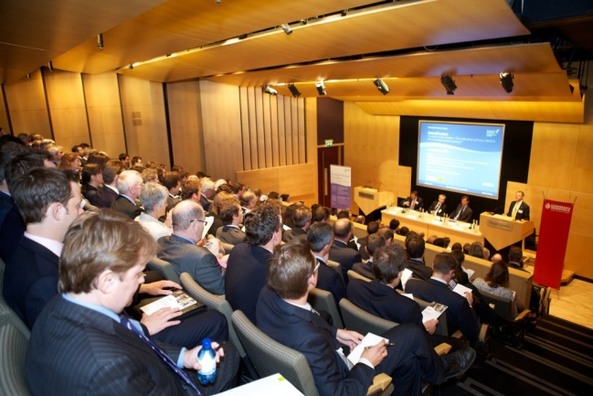
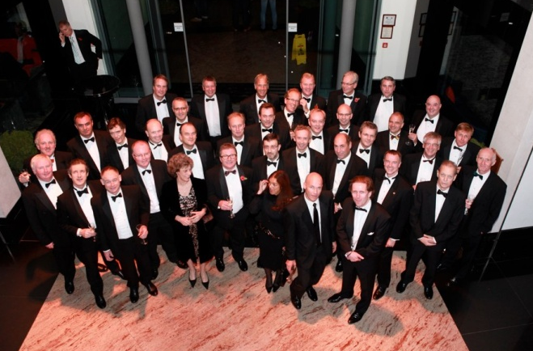
Alumni Events
We run a number of highly successful alumni events throughout the year, including:
2 Breakfast Forums
Annual Dinner
Henley Regatta Day
Annual Lecture
Golf Day
Supporters Event

Slide 8
Alumni Events Highlights
10th Annual Dinner welcomed 500 guests and raised £44,000 our highest amount ever from an event (2 Nov 2011)
First regional reception in Manchester (28 Sept 2011)
Launch of Annual Lecture (9 May 2011) which sold out and received excellent feedback and press coverage
New venue for the Annual Golf Day (19 May 2011) and highest numbers of players to date with 50 alumni and corporate golfers
Breakfast Forum discussion on the topic of ‘Debt’ proved very popular and will now become an annual topic
Notes:
NG – As an engaged and active alumni association we run a number of events of which these are a few highlights:
The annual dinner was a fantastic evening with 400 guests and raising £45,000
Our first Regional event in Birmingham gives us an opportunity to engage alumni outside London
And the Annual lecture is just one of 4 new events this year, including tonight’s supporters event.

Slide 9

RG10 Events
RG10 is the RREF alumni club for graduates of the past decade
Events aimed at career development and networking
  Profile Talks from successful Reading alumni in the profession
  Charity Rugby Match against Oxford Brookes
  Social drinks evenings
Notes:
NG – We also have the RG10 which is an alumni group for graduates of the past decade. We aim to help support them in the early part of their career through events such as the Profile Talks.

Slide 10
Professional Development Events
RREF Annual Real Estate Careers Fair
30 top industry employers come to Reading each year to exhibit to real estate & planning undergraduates and postgraduates at one of the key recruitment events of the calendar
RREF Evening Lecture Series: a programme of weekly lectures on Monday/Tuesday evenings from 6pm-8pm delivered by senior figures from our Corporate Patrons, offering students valuable insight into topical issues and a chance to network with the firm’s recruitment team
Notes:
NG – I’d like to tell you a bit about the careers activities we run: some of you will be familiar with our careers fair and series of evening lectures, offering students valuable insight into topical issues and a chance to network with the firm’s recruitment team.
These grow more popular with employers each year and once again attendance from students has been very strong.

Slide 11
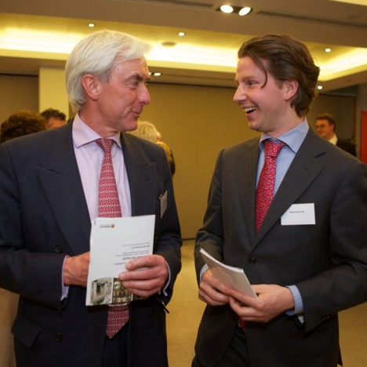
Professional Development
Initiatives
Mentoring Programme
We run a Mentoring Programme for Part 2, 3
and MSc Real Estate & Planning students to
offer them the opportunity to have a one to
one connection with a real estate or planning
alumnus/a in industry.
Access Internship Scheme
We help to place Part 1 and Part 2 full-time students with host firms throughout the summer while they undertake a 4 week internship.

Slide 12
RREF Awards and Bursaries
We provide bursaries to support students with financial difficulties – last year we awarded nearly £50,000 to support Real Estate and Planning students, including a PhD studentship
Throughout the year RREF runs a hardship fund to help with unexpected financial difficulties
We offer RREF & sponsored awards at graduation to reward excellence and outstanding achievements
Notes:
BL –total support undergraduates £8k, MSc £22k, PhD £19k
Awards – ‘most improved student’, ‘most enterprising’, and of course the ‘highest achieving’ at both UG and PG level

