Slide 1
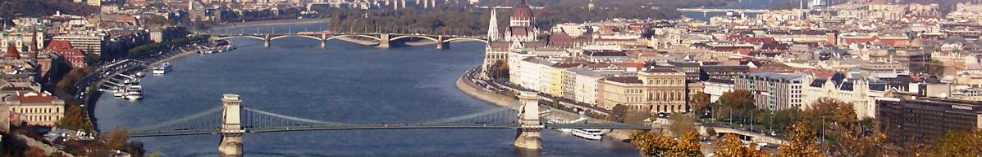

Budapest New Property Policy
Key Performance Indicators to Benchmarking
Zsolt Ferenczy
Property Director of
BFVK – Budapest City Property Management Centre
www.bfvk.hu

Slide 2
Introduction
There are no problems at all! Just challenges!
The asset value is unknown
The heritage: an old, mismanaged, deteriorated cluster of buildings
Missing drawings
Complicated legal situation
Tenants without tenancy agreements
Extremely lengthy legal procedure to vacate occupied properties
Service usage not measured by separate meters, sometimes not even measured
There is no linear corellation between the service bills and the measured m3 quantities due to high standing fees
Comfortable managers’ chairs, no innovation, „why to change, why bother” attitude
www.bfvk.hu

Slide 3
Introduction 2
Construction market sharply dropped
Limited number of new-built office complexes
Strong sensitivity of rental-fee at all companies
The rent is generally the third biggest cost to most companies
Internet give new type of access to each business: the corporate headquarter-look is not so important any more
Growing need for type B offices or lower grade storages
Old buildings get higher comparative values
www.bfvk.hu

Slide 4
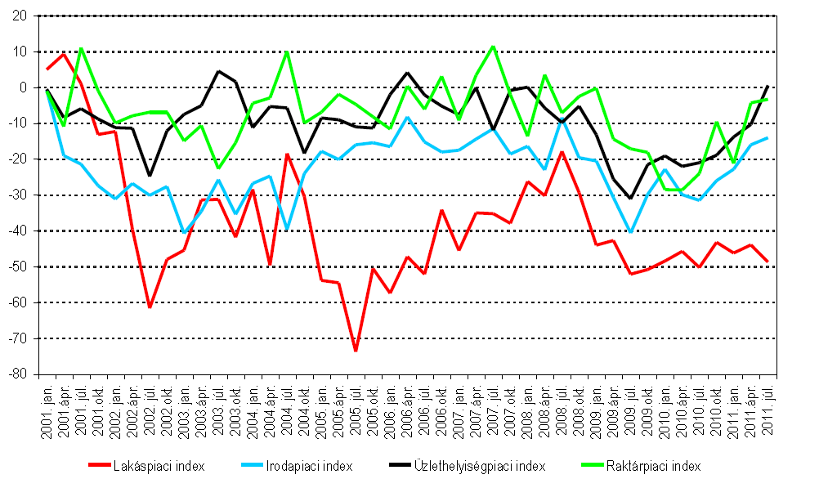
Introduction 3
GKI – Economy Research Institue Report
Property Indexfor 2001-2011
Residential index
Office index
Retail index
Warehouse index
www.bfvk.hu

Slide 5
Develop KPIs - 1
Any value must be realistic and useful for further calculation.
What values can we measure?
performance of bdgs: public utilities, fees of insurance, security, cleaning, etc.
Performance of the management (outsorcing: is it worth or
Is the usage appropriate for its intended purpose
Sustaniability? Do we comply to new requirements? Energy saving, dust collection, noise protection, etc.
www.bfvk.hu

Slide 6
Develop KPIs - 2
What shall our measured value relate to?
Gross external area? (GEA)
Gross internal area? (GIA) – available on architects drawings
Net internal area (NIA) or Gross leasable area?
Net rented area
Common use areas: how to incorporate?
www.bfvk.hu

Slide 7

Develop KPIs - 3
Once we calculated our KPI, where and how shall we use it?
Internal benchmarking: schools to schools
Competition benchmarking: private school to municipal school
Functional benchmarking: waiting room of a hospital to a municipal office
Work Process benchmarking: used electricity of an assistant in various workplaces
www.bfvk.hu

Slide 8

The aims 1
We must stop Property enthropy
Technical obscolescence (deterioration)
Functional obscolescence (new need for small cube offices or „telex rooms”)
Locational obsolescence („slumming”: a a shop in a 50 years ago high-street now is not sought after )
www.bfvk.hu

Slide 9

The aims 2
Target 1
increase income:
  let out more,
  increase lettable area,
  decrease common areas,
  decrease useless areas
  Find new functions
  Good marketing
  Etc.
www.bfvk.hu

Slide 10
The aims 3
Target 2: decrease cost:
  Use Benchmarking to identify weakness
  Obtain low service fees, a group of properties may have better rates
  Rationalize layouts, heating, etc.
  Combine investment with lease: support tenant fitout for mutual benefits
www.bfvk.hu

Slide 11
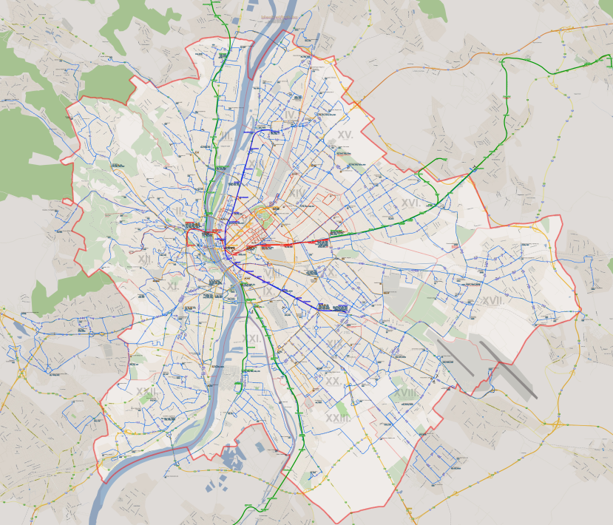
Research
We have selected 5 different properties:
Baross utca 61.
Curia utca 3.
Kassák utca 81.
Gvadányi út 33-39.
Lenkei utca 17-19.
www.bfvk.hu

Slide 12
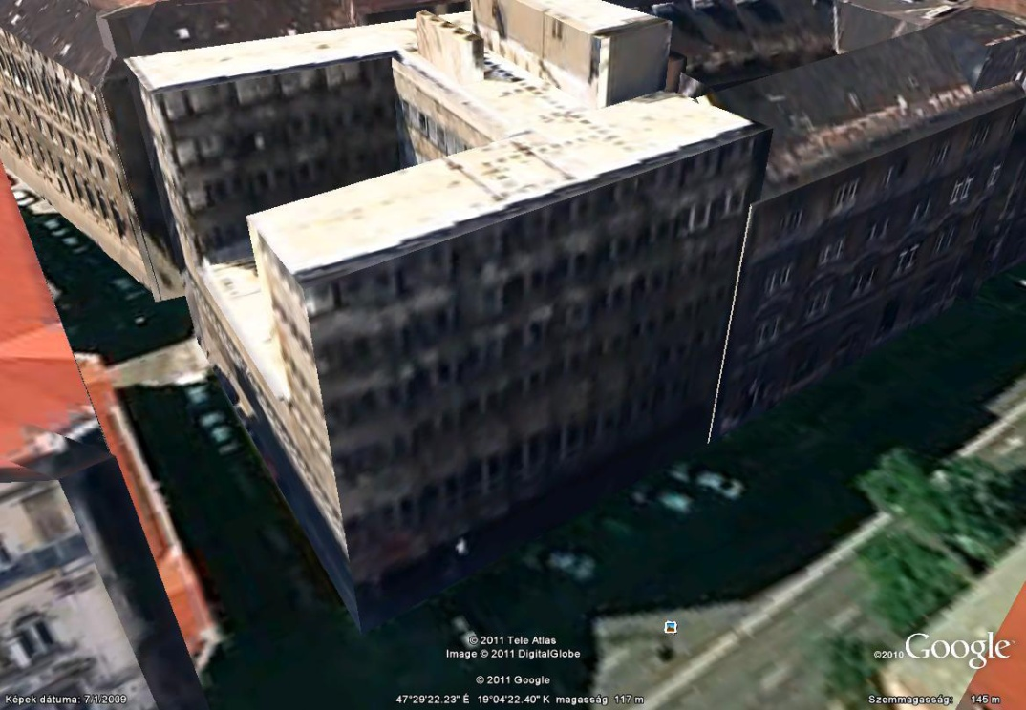
Baross 61 (Office)
4000m2 office block, fully let. Slum area,
50 years old concrete/brick building

Slide 13
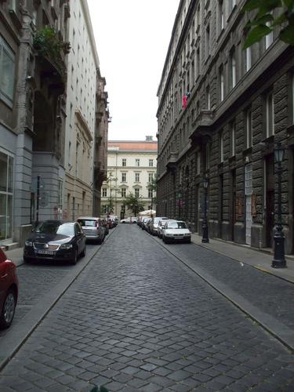
Curia utca 3. (Office)
6000m2 office block, fully let. Prime
location, good leasable/total ratio
80 years old brick building

Slide 14
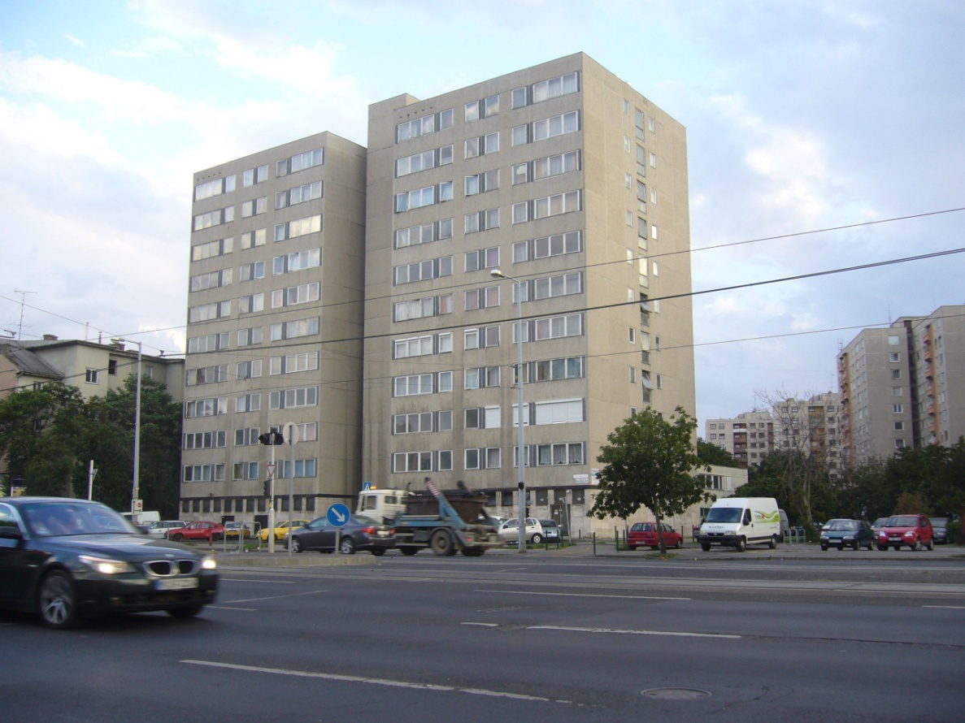
Kassák utca 81. (Residential)
6000m2 residential, 10-storey high plattenbau building, 80 flats.
partially let. Mid-location, 40 years old concrete building. No insulation,
old timber windows

Slide 15
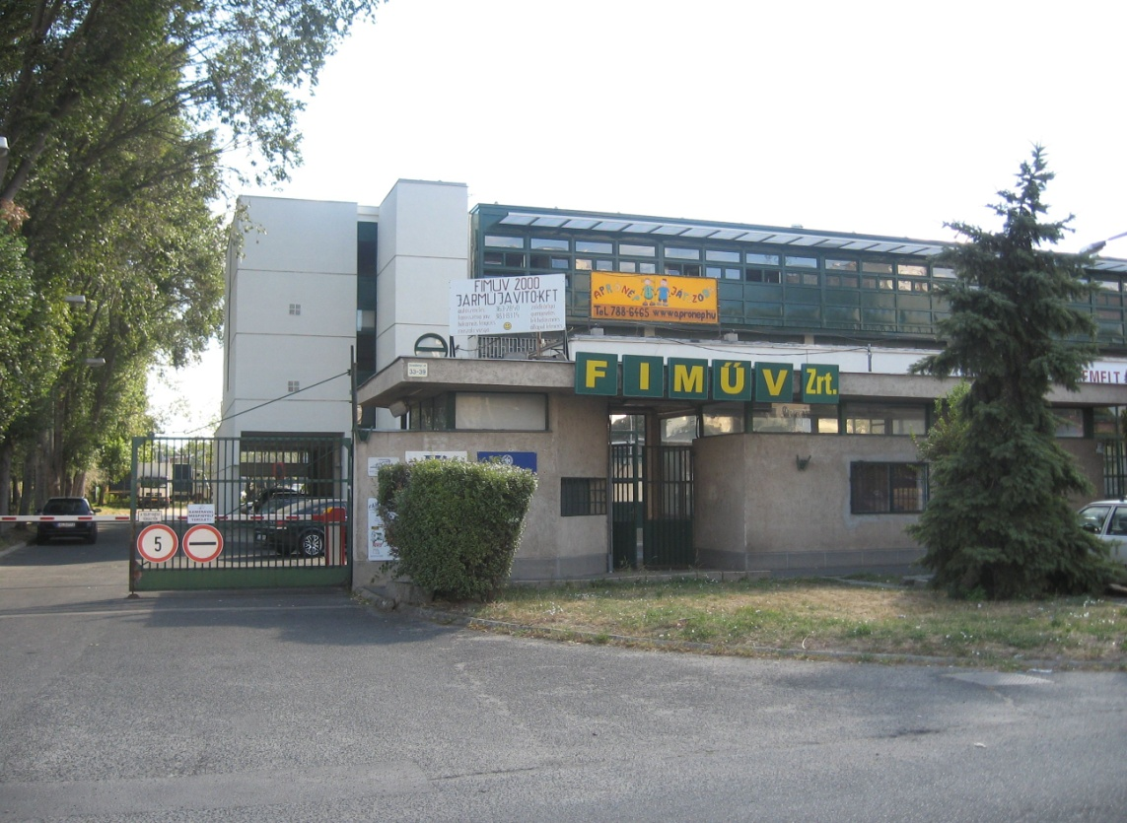
Gvadányi út 33-39. (Office/storage)
30 years old prefab concrete purpose built facility with district heating.

Slide 16
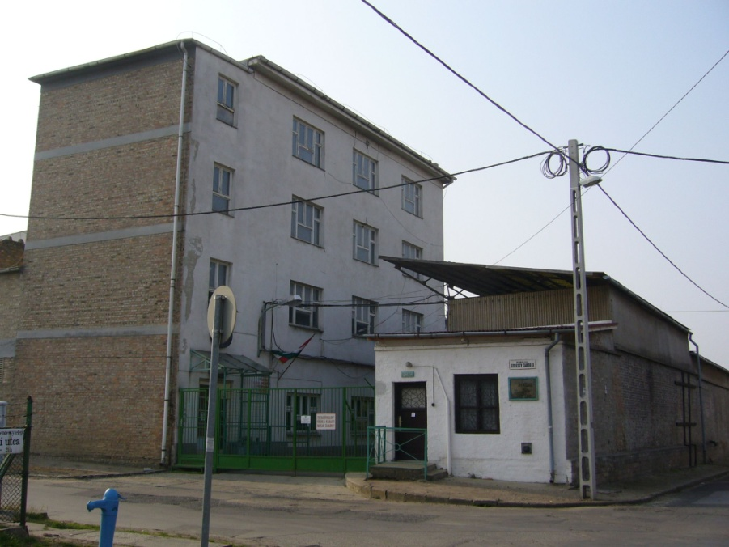
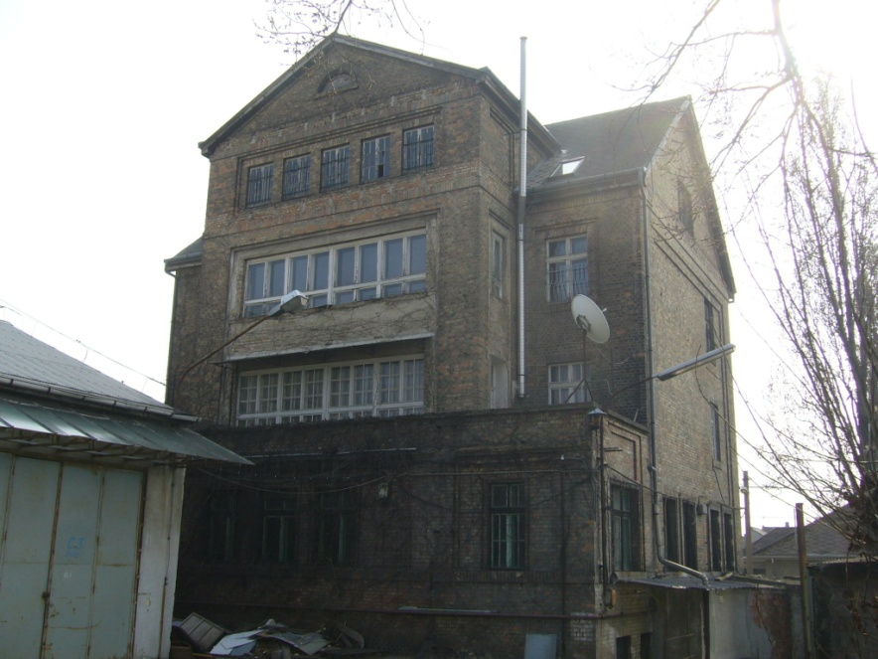
Lenkei utca 17-19
100 years old complex, including garages, office buildings, open stores, workshops, and even a kindergarden!

Slide 17
KPIs
This table shows some of the calculated KPIs
 |  |  |  |  |  | Annual billed fees (EUR) |  |  |  |  | KPI (EUR/rented m2)
 | Address | Function | Gross Internal Area (m2) | Gross Leasable Area (m2) | Rented area (m2) | Electric bill | Water/ sewage bill | Gas bill | District heating | Management | Electric | Water Sewage | Gas | Distr. heat | Mgmnt
1 | Baross utca 61. | Office | 4000 | 3200 | 3200 | 6 667 | 1260 | 21 903 | 0 |  | 2,08 | 0,39 | 6,84 | 0,00 | 0,00
2 | Curia utca 3. | Office | 6000 | 3609 | 3609 | 15333 | 1130 | 14843 | 0 |  | 4,25 | 0,31 | 4,11 | 0,00 | 0,00
3 | Kassák utca 81 | Residential | 5200 | 4480 | 1280 | 13746 | 3333 | 0 | 140 | 18293 | 10,73 | 2,60 | 0,00 | 0,11 | 4,08
4 | Gvadányi út 33-39. | Office/storage | 4300 | 4066 | 1339 | 16666 | 1580 | 0 | 33333 | 2000 | 12,45 | 1,18 | 0,00 | 24,89 | 1,49
5 | Lenkei utca 17-19. | Office/workshops | 6000 | 3150 | 784 | 7666 | 1333 | 19133 | 0 |  | 9,78 | 1,70 | 24,40 | 0,00 | 0,00
 | Note: Gross Internal Area includes all non-rented rooms (basement, boiler rooms, corridors, receptionist toilet, etc)
www.bfvk.hu

Slide 18
Conclusion
Compare apple to apple
Use good judgement of values, They may not be right!
Each property is different, but the target is the same!
A happy tenant is the only tenant: if a KPI sharply rise or diminish, something is wrong and the tenant will action at once!
Collect and collect data
To repeat Montecuccoli: You need 3 things for benchmarking:
Data, Data and Data
www.bfvk.hu

