Slide 1
PPPs as special forms of financing public infrastructure
21 October 2011
Botond Fehér

Slide 2
Contents:
Introduction of HYPO NOE Gruppe Bank AG
PPP basics
CEE impressions
Current Market issues

Slide 3
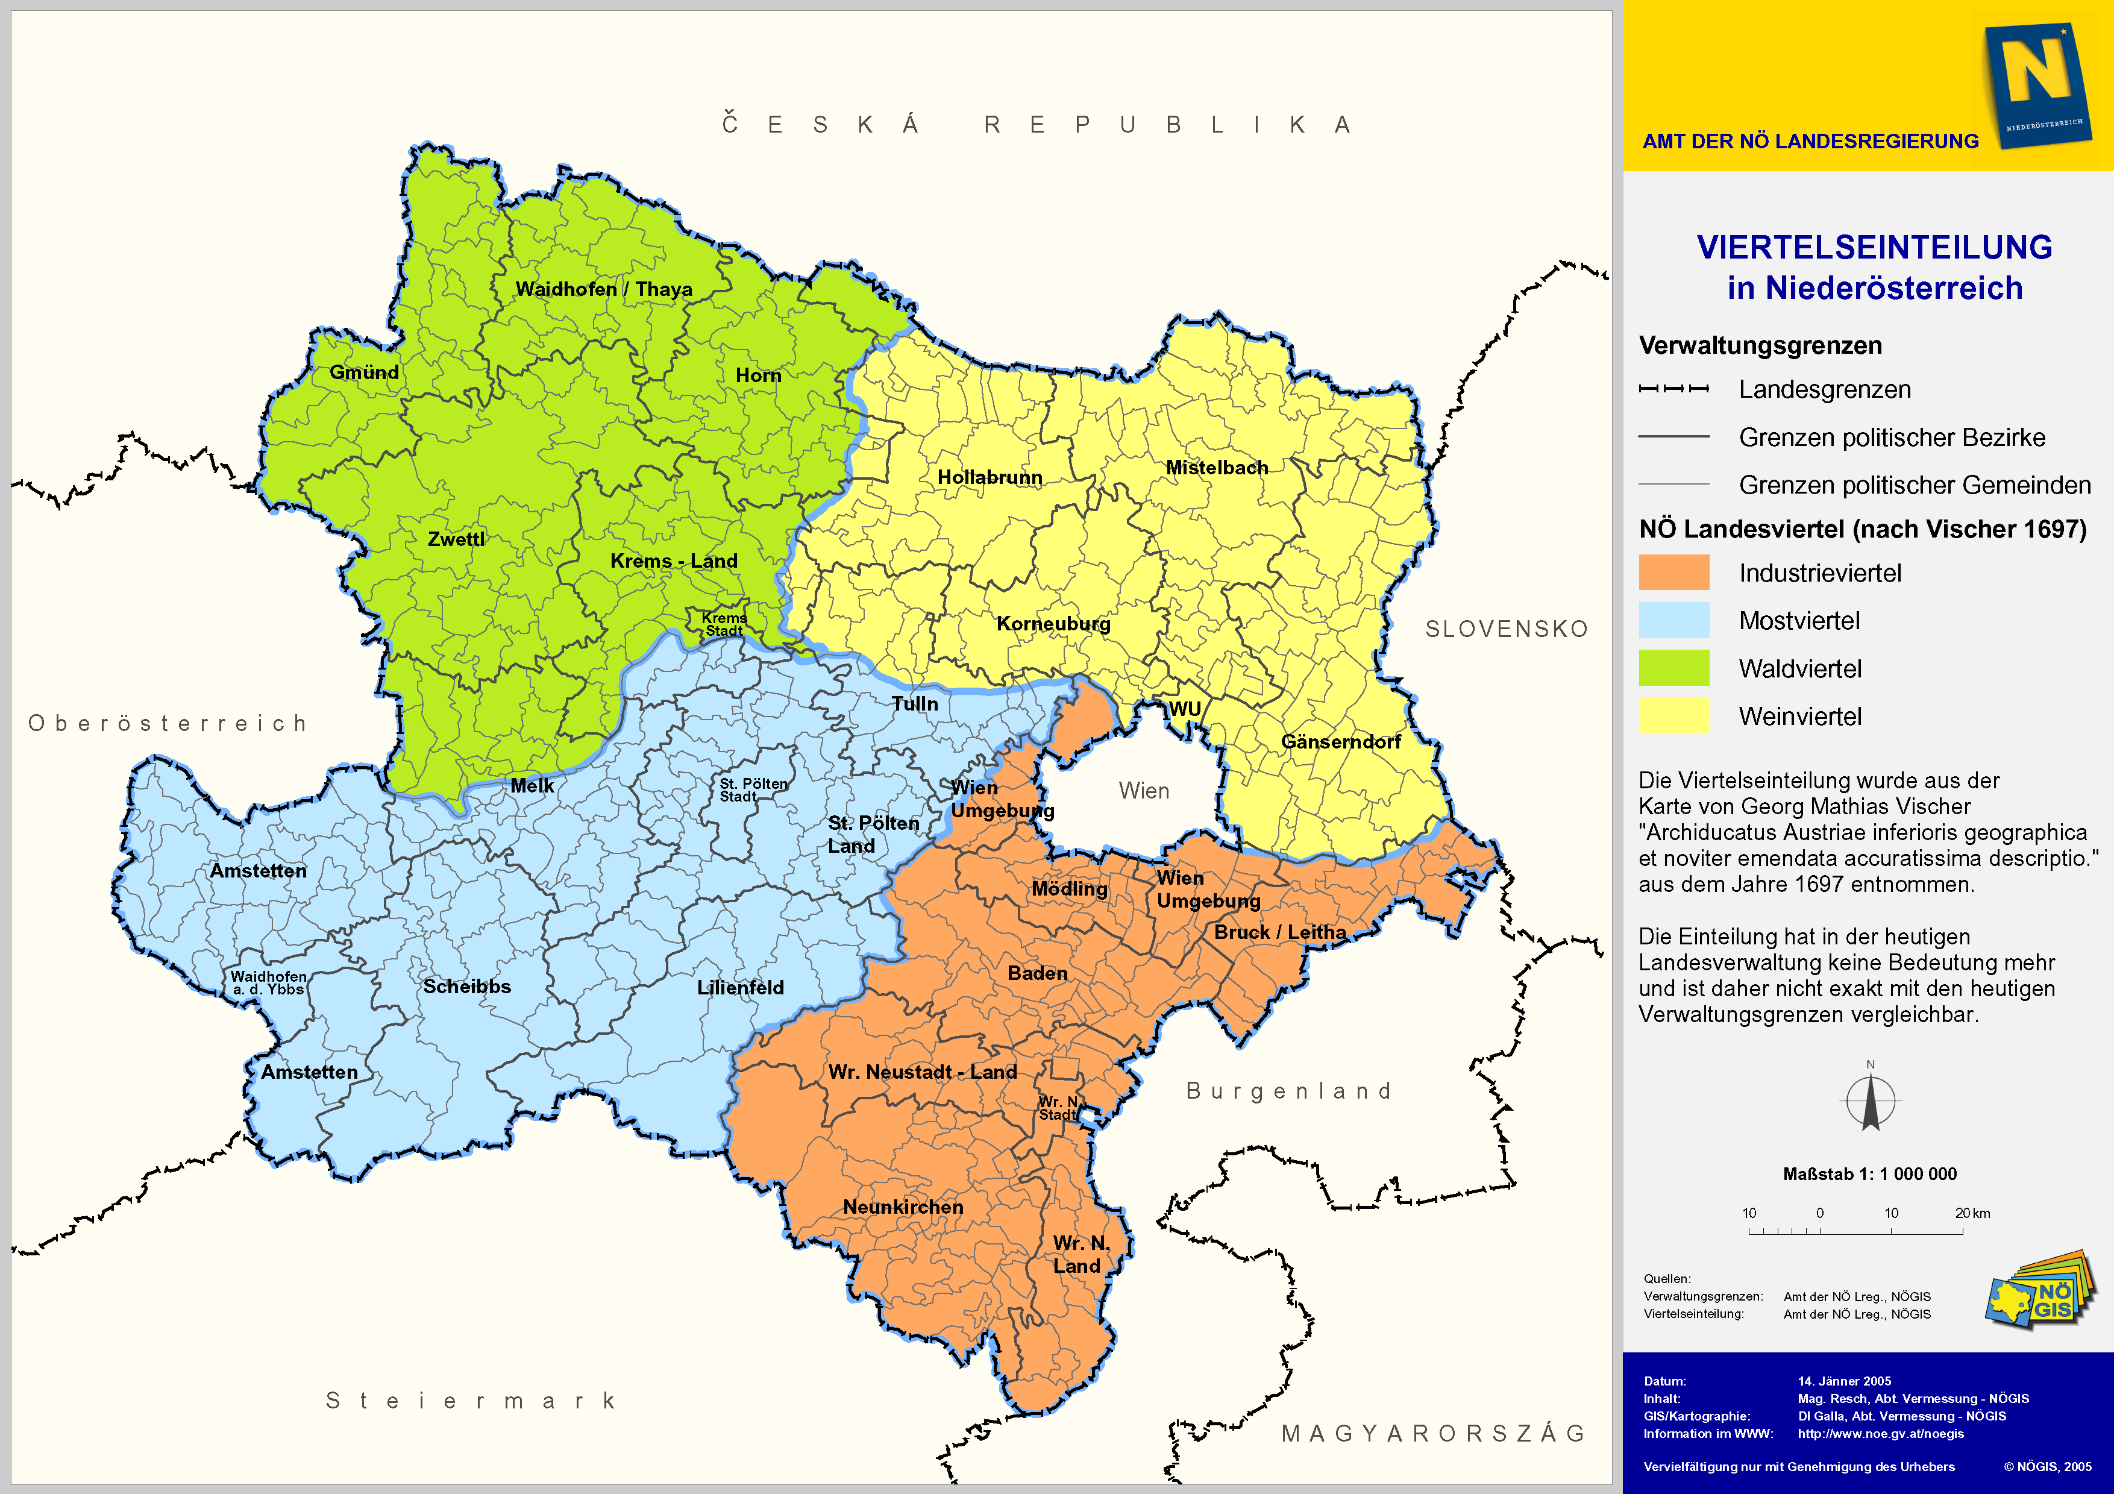
History
1888 Establishment of a regional mortgage bank for Lower Austria
1992 Founding of Niederösterreichische Landesbank-Hypothekenbank AG Shareholder: 100 % Province of Lower Austria
1996 Partial privatisation: Shareholders: 74 % Province of Lower Austria, 26 % ÖVAG
1999 Change in shareholders’ stakes to 59 % State of Lower Austria and 41 % ÖV AG
2007 Retransfer of all ÖVAG shares to the Province of Lower Austria
2010 Rebranding: HYPO NOE Gruppe Bank AG

Slide 4
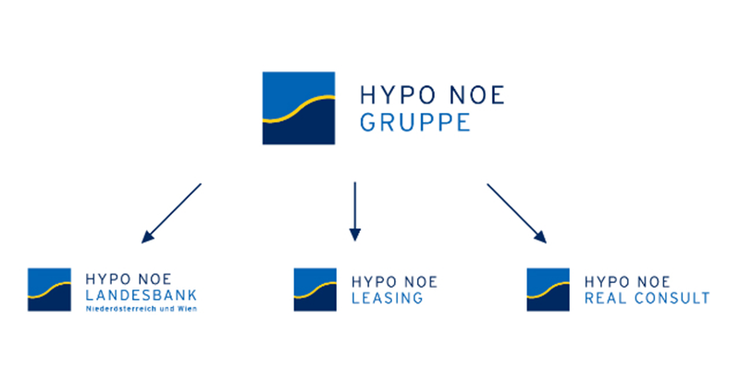

Slide 5
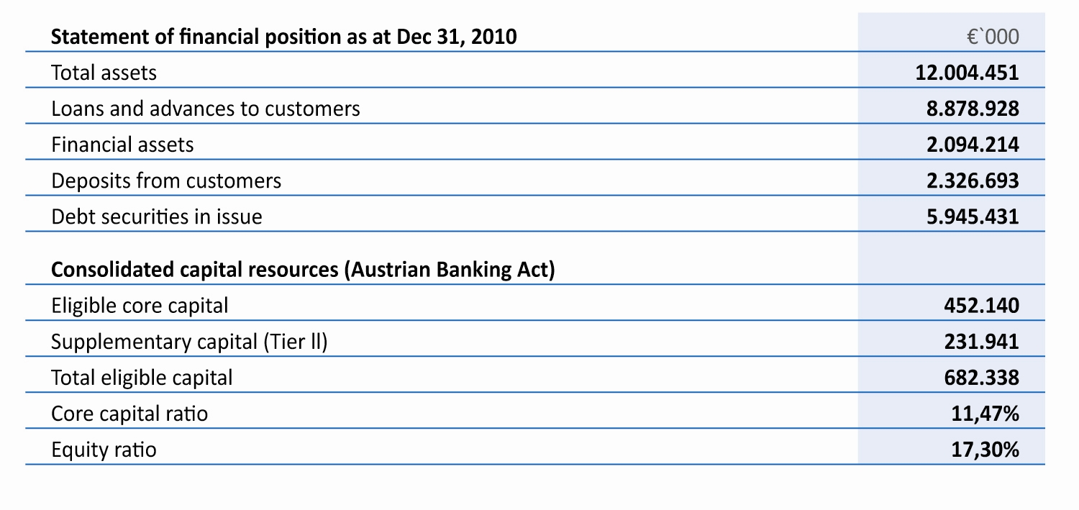
Financial statements of HYPO NOE Group as per 31.12.2010

Slide 6
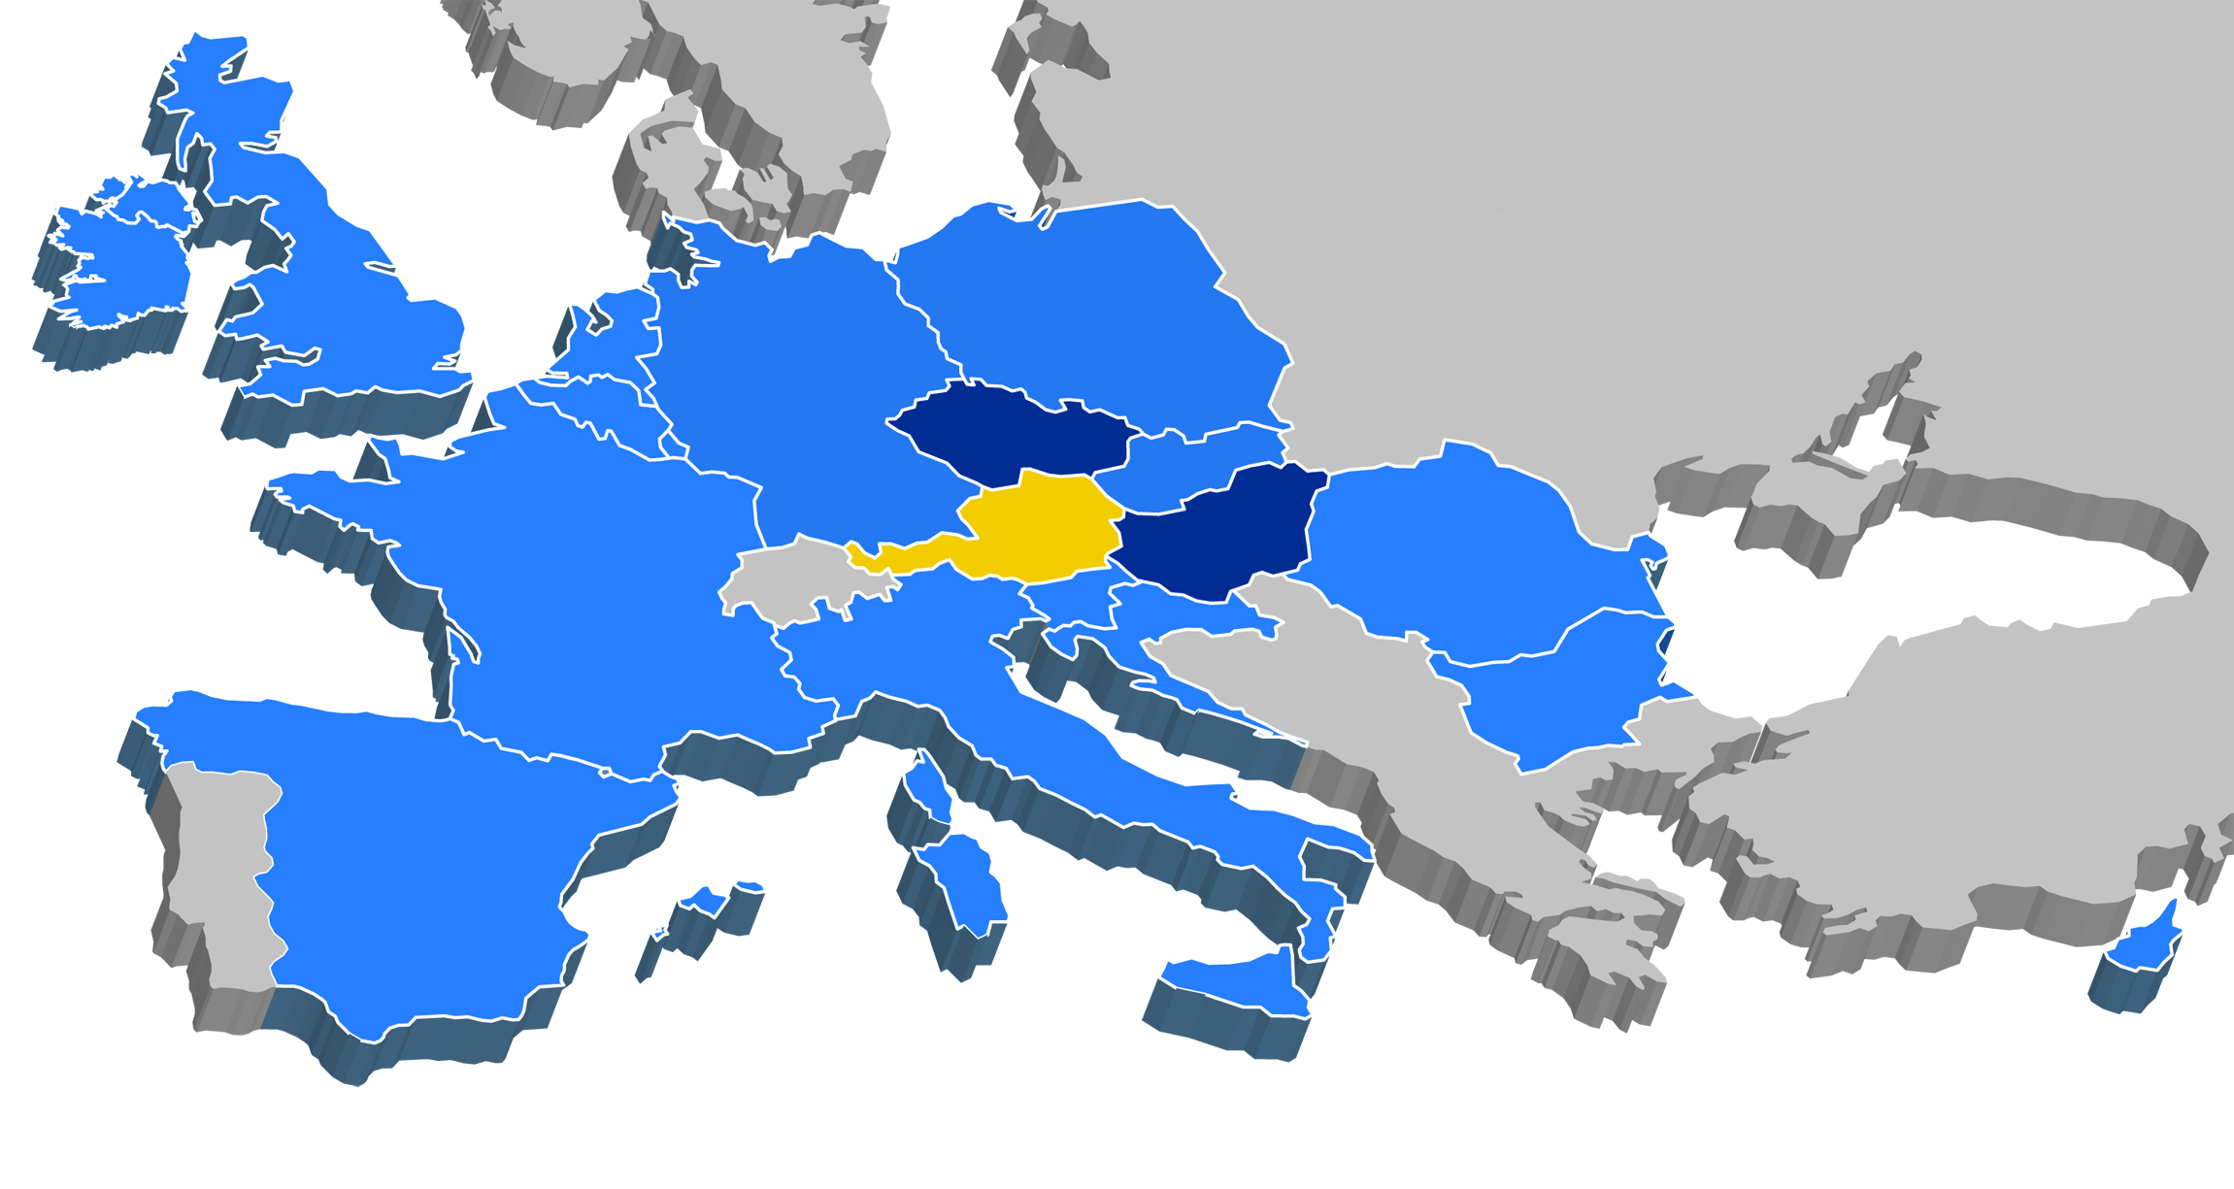
Our Markets:
Headquarter:
Austria
Representative office:
Hungary, Czech Republic
Cross border finance

Slide 7
Our Financing Activities:
Public Finance
Countries
Cities
Municipalities
Classic Infrastructure
Transport
Energy
Waste management
Utilities
Social Infrastructure
Schools, universities
Hospitals, health care sector
Public buildings
Corporates

Slide 8
Our (Public Finance) Products:
Tailor made financing solutions & advising services
Loans & financing products similar to loans
(e.g. Schuldschein, Private Placement)
Project Finance
Financing solutions custom-made & Consulting services
Public Private Partnerships
Forfaiting
ECA covered solutions
Refinancing via OeKB, KfW, EIB
Treasury products
(e.g. interest rate hedging)

Slide 9
Definitions
PPPs are aimed at increasing the efficiency of infrastructure projects by means of a long-term collaboration between the public sector and private business. A holistic approach which extends over the entire lifecycle is important here.
Source: German PPP Task Force, German Transport,
Construction and Housing Ministry (Bundesministerium für
Verkehr, Bauen and Wohnen)
The term public-private partnership (“PPP”) is not defined at Community level. In
general, the term refers to forms of cooperation between public authorities and
the world of business which aim to ensure the funding, construction, renovation,
management and maintenance of an
infrastructure of the provision of a service.
Source: Green Paper on Public-Private Partnerships and
Community Law on Public Contracts and Concessions
presented by the European Commission

Slide 10
Definitions
Any medium-to-long term relationship between the public and private sectors, involving the sharing of risks and rewards of multi-sector skills, expertise and finance to deliver desired policy outcomes.
Source: Standard & Poor’s PPP Credit Survey
‘Public-Private Partnership’ is a generic term for the relationships formed between the private sector and public bodies often with the aim of introducing private sector resources and/or expertise in order to help provide and deliver public sector assets and services. The term PPP is, thus, used to describe a wide variety of working arrangements from loose, informal and strategic partnerships, to design build finance and operate (DBFO) type service
contracts and formal joint venture companies.
Source: European Investment Bank

Slide 11
The trend of municipal financing in CEE (Source EBRD)
DECENTRALISATION
Sovereign-backed loans
Cheap but politicised
Municipality loans
Self-financing independence for cities
Higher cost and burden on city debt book
Utility loans supported by cities
Off-balance sheet borrowing for the city
Need to be backed
Utility corporate loans or bonds
Self-financing independence for utilities
Entirely based on company creditworthiness
PPP/concessionaire loans
Private sector indebtedness

Slide 12
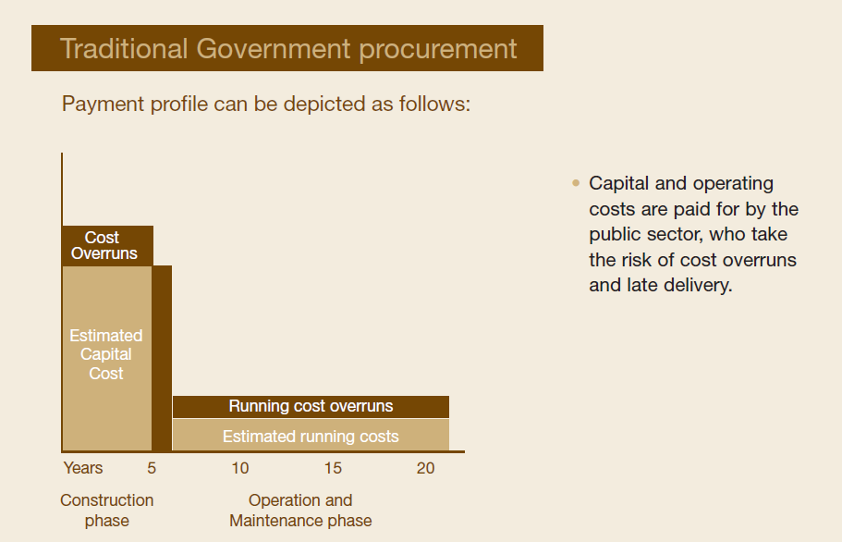
Source: PWC

Slide 13
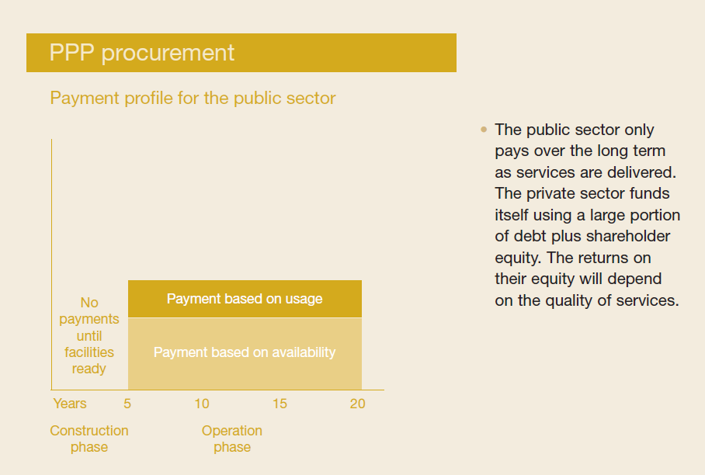
Source: PWC

Slide 14
Public Sector Comparator
PPP is a public procurement alternative
Conventional
procurement
PPP
Comparison
Of pros/cons
100% comparison ist not possible
Organization of the procurement process is possible
through checklist to own state office

Slide 15
Planning progress vs.
Room for maneuver and creativity
In order to maximize the value added by the private partner it is important to invite him as early as possible
Planning progress
PPP
Complexity
Creativity
Time

Slide 16
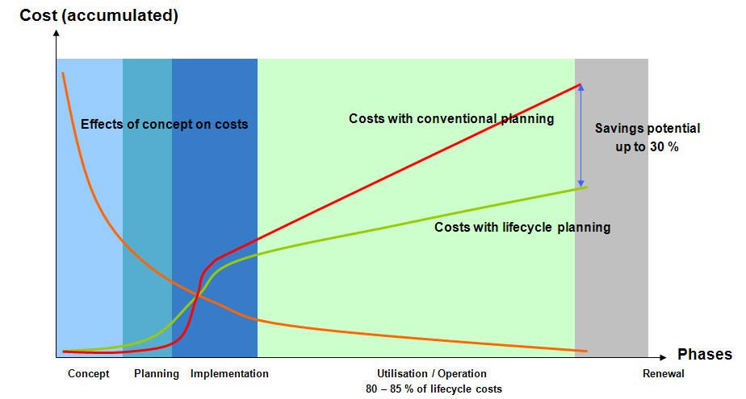
Savings from lifecycle approach (Source: VAMED)

Slide 17
The Benefit of a PPP approach (Source: Hill International)
POTENTIAL
PPP
Range of Uncertainty /
Risk / Opportunity
Post-Contract Opportunity
Traditional Procurement
DEFINITE
Design & Build Procurement
Contract Award
OUTCOMES
DESIGN
CONSTRUCTION
TIME

Slide 18
Motorway Density in Germany

Slide 19
Motorways in Poland

Slide 20
2 out of 3 rule
Eurostat-decision 11. February 2004:
→ Risk transfer is the main criteria for the classification as PPP
Construction Risk
Availability Risk
Demand Risk
„The private Sector has to bear the construction risk
and at least one
out of the demand- or availability risk!"

Slide 21
BOT – and its alternatives
BBO Buy Build Operate
BT Build Transfer
BTO Build Transfer Operate
BOT Build Operate Transfer
BOOT Build Own Operate Transfer
BOOST Build Own Operate Subsidize Transfer
DBO Design Build Own
DBOOT Design Build Own Operate Transfer
DBFO Design Build Finance Operate

Slide 22
3. Risk Considerations and Bankability
Revenue based Credit Risk (Source: NORD/LB Mathias Pahlke)
Credit
Risk
Pure Infrastructure
Marketable Infrastructure
Social Infrastructure
Quasi Government
PPP Project
Pure Government
Revenue Risk Transfer

Slide 23
CEE market impressions
Legal framework is sufficient but lack of verified solutions and standard procedures
PPP is treated as a pure financial model for closing funding gaps for the public sector (e.g. Motorways)
Off budget financing still important but less bankable
Problems with life-cycle approach (Marriage male/female roles)
At municipal level lack of knowledge and professional skills
Sufficient number of project killed in the negotiation phase
Public side is not able to understand and willing to bear pre-feasibility costs (need of constant education)
Use of EU funds and financial vehicles to leverage PPPs (EIB, EBRD, EPEC, …)

Slide 24
Impact Of Government Ratings
on Corporates
(Source: Infranews 15. September 2011)
further downgrades in the sovereign credit ratings of
weaker euro zone countries is a growing concern to infrastructure developers
sharp hikes in borrowing costs as a consequence
own ratings will fall in line with those of their governments
sovereign downgrading has a significant impact on the liquidity of European banks
Impact on deal sizes
large infra developers potentially access cheaper debt than their governments (but by no more than two notches – S&P)

Slide 25
HYPO NOE Gruppe Bank AG
Wipplingerstraße 4
1010 Vienna
Phone: +43(0)5 90 910-1551
Fax: +43(0)5 90 910-1551
E-Mail: pfinternational@hyponoe.at

