Slide 1
Taming the Elephant
Persuading landlords to invest in energy efficiency
Bob Thompson
RETRI Group
bt@retrigroup.com
@realindustrial
Qiulin Ke
Nottingham Trent University
Qiulin.ke@ntu.ac.uk

Slide 2
Conventional supply model
Energy supplier
Energy supplier
Energy supplier
Landlord
Tenant
Tenant
Tenant
Tenant
Tenant
Tenant

Slide 3
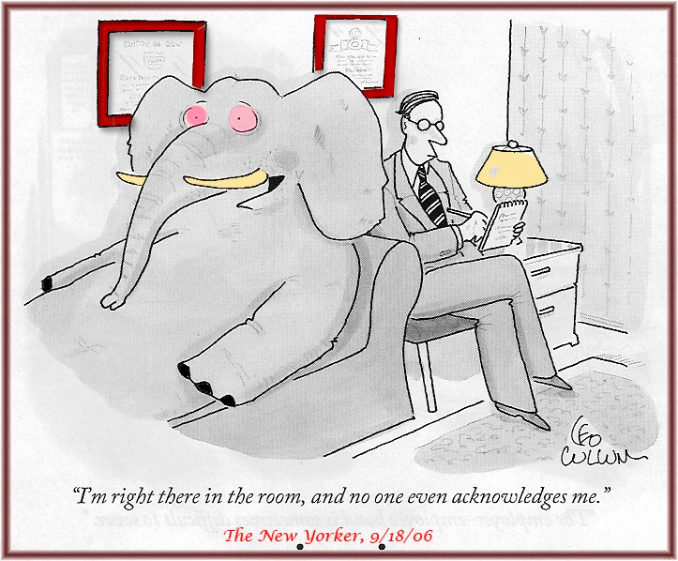

Slide 4
Key drivers for investment in energy efficiency
1 | Energy cost savings
2 | Government/utility incentives/rebates
3 | Enhanced brand or public image
4 | Greenhouse gas footprint reduction
5 | Increasing energy security
6 | Existing government policy
7 | Customer attraction/retention
8 | Pending/anticipated government policy
Source: EEI Survey (2011)

Slide 5
Barriers to energy efficiency

Slide 6
Conventional supply model
Energy supplier
Energy supplier
Energy supplier
Landlord
Tenant
Tenant
Tenant
Tenant
Tenant
Tenant

Slide 7
Conventional supply model
Energy supplier
Energy supplier
Energy supplier
Landlord
Tenant
Tenant
Tenant
Tenant
Tenant
Tenant
INVESTMENT = REDUCED COSTS

Slide 8
Conventional supply model
Energy supplier
Energy supplier
Energy supplier
Landlord
Tenant
Tenant
Tenant
Tenant
Tenant
Tenant
INVESTMENT = INCREASED COST
REDUCED COSTS
Increase in rent?
Increase in value?

Slide 9
ESCO supply model
Energy supplier
Increase in rent?
Increase in value?
Landlord
ESCO
Power Generation
Reduced operating costs
Potential return
Defrayed business risk
Tenants

Slide 10
UK lags behind

Slide 11
Barriers to ESCO development
Low awareness of and lack of information about the ESCO concept;
Mistrust from the clients;
High perceived technical and business risks;
Public procurement rules and accounting rules (including off balance sheet regulations);
Lack of accepted standardized measurement and verification procedures;
Administrative hurdles and high transaction costs;
Principal/agent dilemma with split incentives ;
Aversion to outsourcing energy;
Lack of appropriate forms of finance;
Low priority of energy efficiency measures.

Slide 12
Conclusions – ESCO gives
Potentially significant ROI
Better environmental outcomes
Potentially higher rents and values
BUT WE NEED
Better exposition of the costs and benefits of the ESCO approach;
Better understanding of the energy/ utility requirements of building occupiers;
Better promotion of the concept to property owners and landlords

