Slide 1

Office Real Estate Investment in the World City Network: The Effects of Financial Crisis
ERES Annual Conference
Edinburgh, June 2012
Colin Lizieri, Kathy Pain and Sandra Vinciguerra
Dept of Land Economy, University of Cambridge
Henley Business School, University of Reading
In memory of Andrew Pain 1981-2012

Slide 2
ESPON - TIGER
ESPON
  the European Spatial Planning Observation Network (2002-2006)
  European Observation Network on Territorial Development and Cohesion (2008-2013 programme)
  EU funded Research Network carrying out applied research on “territorial dynamics” and providing evidence base for regional spatial policy development.
TIGER
  “Territorial Impact of Globalization for Europe and its Regions”
  Aim: to understand the impact of globalization on European regions and cities and to examine spatial flows from globalisation at a European level.
Partners
  IGEAT-ULB (Belgium), Sapienza - Università di Roma (Italy); University of Reading (UK); NIGGG - Bulgarian Academy of Sciences (Bulgaria); CNRS (France), Jönköping International Business School (Sweden)

Slide 3
The Space of Flows and Place of Work
Firms, businesses, individuals linked together in set of overlapping networks … cities act as nodes in flows of information, capital etc.
In an internet-enabled world, people can, in principle, work anywhere … but they must work somewhere.
Offices, agglomeration and clustering – particularly in international financial centres, creation of critical mass of office space used by FBS, APS firms.
Capital flows to create and invest in that space – which is then locked down spatially.
Can we capture and explain those flows, as a proxy for integration in global financial system?

Slide 4
Dataset
Data provided by Real Capital Analytics
  Commercial real estate transactions 2007-2010
  Top 1,000 transactions in each year, 3,974 sales, $888billion
  2,744 sales, $580billion excluding land sales
  1594 office sales, $361billion => 62% by value of non-land sales
Information available/collected includes property location, price, buyer name and their location
Trace and aggregate information to city level – estimate dyads (capital flows from city one to city two) and self-investment.
Acknowledge definitional issues: ownership in a world of real estate funds, location, arms length transactions.

Slide 5
Analysis of the Network of Flows
TIGER Aims to Trace Globalisation Flows in European and International Territorial Space
Visualization Techniques Based on Network Analysis
Aim to Reveal Position of Cities in Terms of Importance and Centrality in Global Investment Flows
Apply “Spring Embedded Algorithm” to Data
  Forces assigned to each link (reflecting flows between dyads)
  Iterative process changes “distance” between nodes
  Approximate equilibrium position with node sizes and links proportional to flows
  Can add geographical locks

Slide 6
Sales Activity and the Global Financial Crisis

Slide 7
National Office Investment Inflows 2007-2010

Slide 8
National Office Investment Outflows 2007-2010

Slide 9
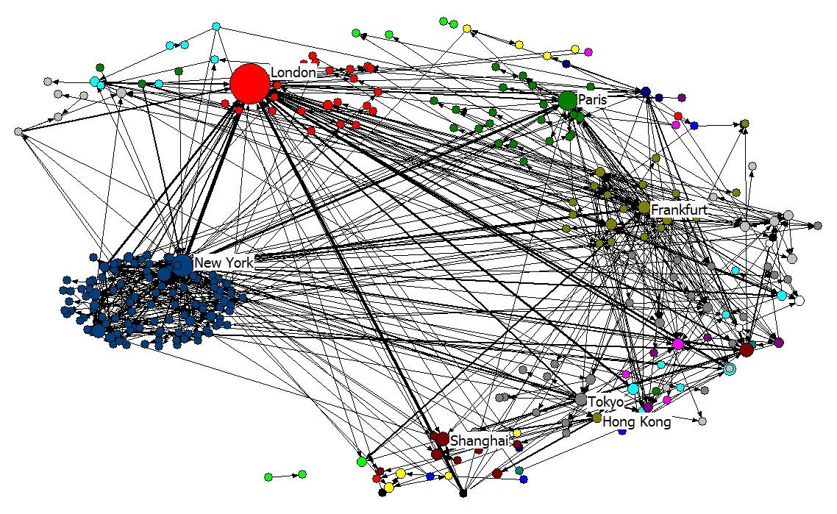
Global office market inflows, 2007-2010

Slide 10
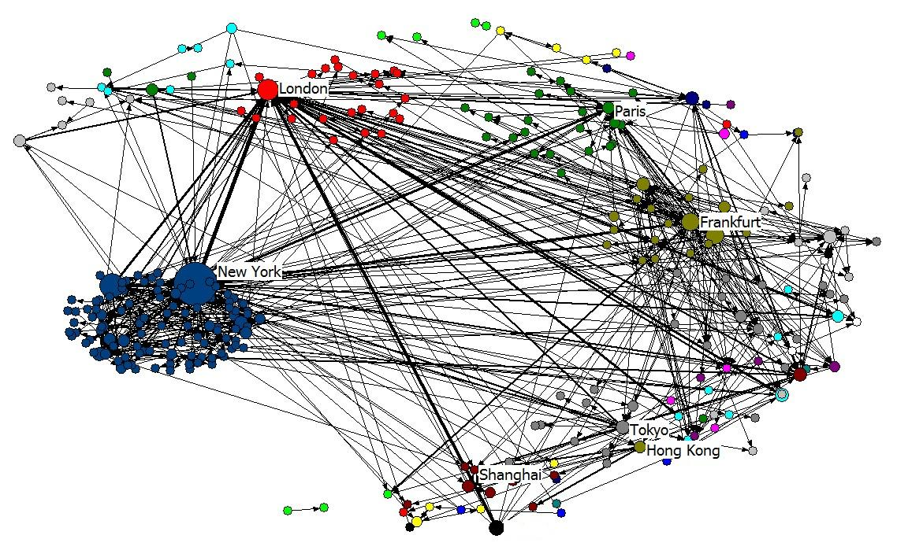
Global office market outflows, 2007-2010

Slide 11
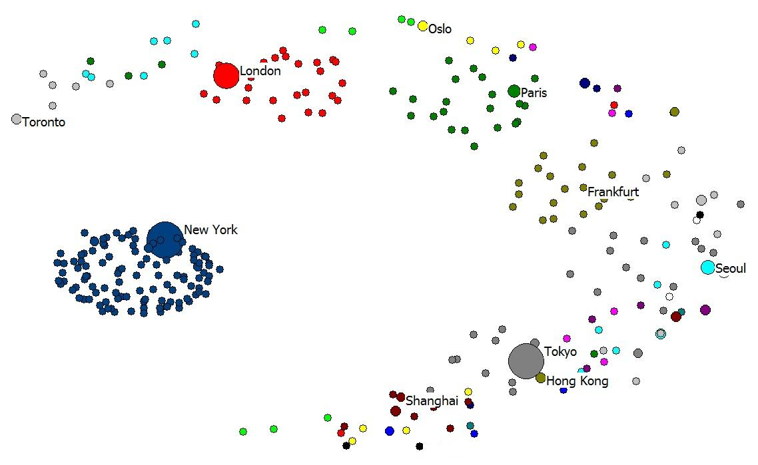
“Self-Investment” 2007-2010

Slide 12
Thinning Out the Network: Inflows 2007

Slide 13
Thinning Out the Network: Inflows 2010

Slide 14
Financial Networks and Investment Flows
0.604 correlation between GaWC FNC and Investment uncorrected for size, region etc.

Slide 15
Capital Flows and the Urban Hierarchy
How Do City Investment Flows Relate to Global System of Cities? Using GaWC 2008 and GIFC10
 | City Investment | Capital Inflows | Self Investment | Capital Outflows | Network Flows
GaWC GNC 08 | 0.598 | 0.561 | 0.525 | 0.484 | 0.593
GaWC FSNC 08 | 0.604 | 0.561 | 0.538 | 0.489 | 0.579
Z/Yen GIFC10 | 0.619 | 0.577 | 0.538 | 0.560 | 0.651

Slide 16
Investment Concentration: Target Cities
Office Market Acquisitions 2007-2010

Slide 17
Investment Concentration: Outflows
Office Market Acquisitions 2007-2010
O.59 correlation between inflows and outflows

Slide 18
Conclusions, Implications and Issues - 1
Office Market Investment Strongly Concentrated
  Capital flows into cities
  Capital flows from cities
  Capital formation within cities
Target and Source Cities:
  Major International Financial Centres
  Key nodes in APS networks
Office Investment:
  Locks capital to spatial locations
  Locks major cities together & to global capital markets
  Systemic risk & contagion: the Towers of Capital hypothesis

Slide 19
Conclusions, implications and issues - 2
Some Questions and Issues Raised:
Do real estate capital flows proxy for integration into global financial / APS networks?
Causality issues: does city status cause capital flows or do flows drive city status?
What are the implications for city economic growth strategies? What are benefits and costs of financial cluster strategies?
Longer term signals and emerging markets: land sales as a precursor to urban restructuring?

