Slide 1
ERES 2012
The implications of a change in the mode of study for a postgraduate real estate programme in South Africa
(Work in progress)
Graeme Jay
University of the Witwatersrand

Slide 2
BACKGROUND
AND
RESEARCH PROBLEM

Slide 3
University of the Witwatersrand (WITS)
School of Construction Economics and Management (CEM) is housed within the Faculty of Engineering and the Built Environment.
CEM offers 3 undergraduate degrees:
  Quantity Surveying Studies
  Construction Management Studies
  Property Studies
Property Studies is a new degree having been only introduced in 2001. The first group of graduates graduated in 2005.
It has been noted that property studies as field of study is new in South Africa and has only been offered as a path of study in the last few years (Cloete, 2002).

Slide 4
University of the Witwatersrand (WITS)
CEM primarily offers 2 postgraduate degrees:
  Postgraduate Diploma in Property Development and Management
  MSc (Building)
Both qualifications are offered primarily on a part-time basis with students generally attending evening lectures twice a week (depending upon what electives are chosen).

Slide 5
Overview of selected literature and research problem
As indicated, real estate or property studies is relatively new field of study in South Africa (Cloete, 2002). The growth in postgraduate programmes has been rather slow as well.
There are in essence only 3 universities in South Africa that offer postgraduate property education.
Typically, most real estate professionals in South Africa have a building or construction type background or finance and accounting type background.
Chivers (2007) notes that there is increasing pressure on professionals generally to improve their qualifications in order to keep their careers moving forward.
There is potentially a trade off between the costs of studying for both the individual and organisation and the time taken out of the work environment versus the benefits of the professional improving their professional competence (Chivers, 2007; Woodward, 1996).
Ulhoi (2005) states that postgraduate education is continuously subjected the ongoing demands of various stakeholders.

Slide 6
Overview of selected literature and research problem
According to Le and Tam (2008), factors affecting student retention and attrition in higher education have been the subject of a vast and varied amount of research over the past 30 years.
Wong, Shen and McGeorge (2002), note that the traditional part-time face-to-face methodology of lecture delivery is impossible where a programme seeks to attract students who are employed on a full time basis and those who live some distance away from the institution.
A lecture programme featuring block release workshops or lectures during the year allows students to work and also travel to attend lectures (Wong, Shen and McGeorge, 2002).
The mode of study may impact upon the quality of the educational service that students experience (Hagel and Shaw, 2010).
How does this impact upon the curriculum development of the postgraduate real estate degree in South Africa (particularly at WITS) as well as the manner in which these degrees are offered?

Slide 7
Methodology
One sample groups was identified, namely; the current postgraduate class (2011).
A questionnaire was developed.
The questionnaire was administered in class and 30 out of 30 responses were received, although on that day a number of students were not in class as it was an optional class.
Responses were analysed .

Slide 8
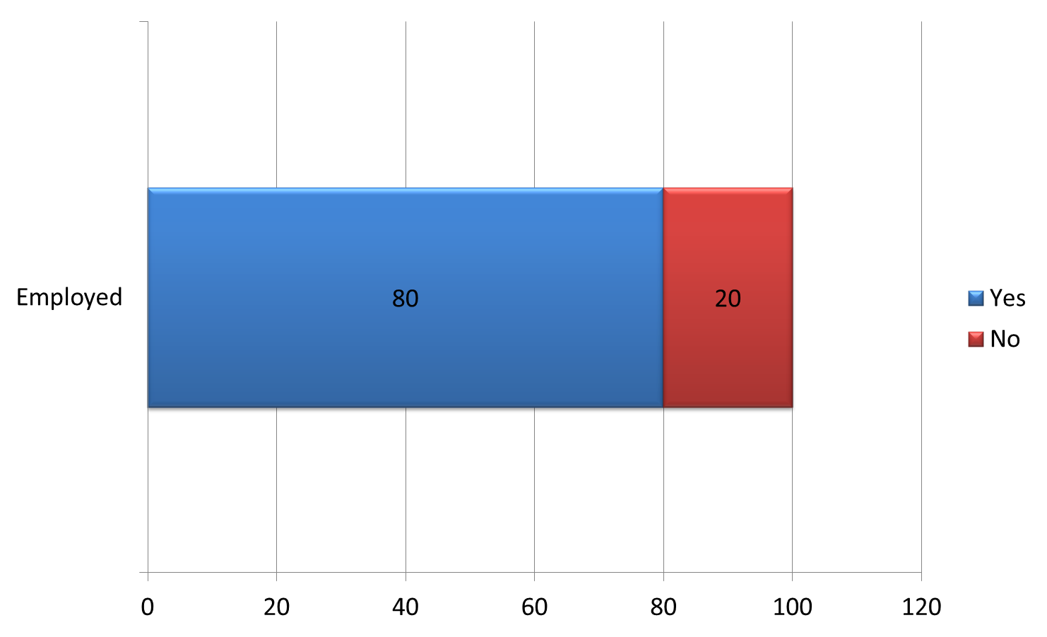
Are you currently employed?

Slide 9
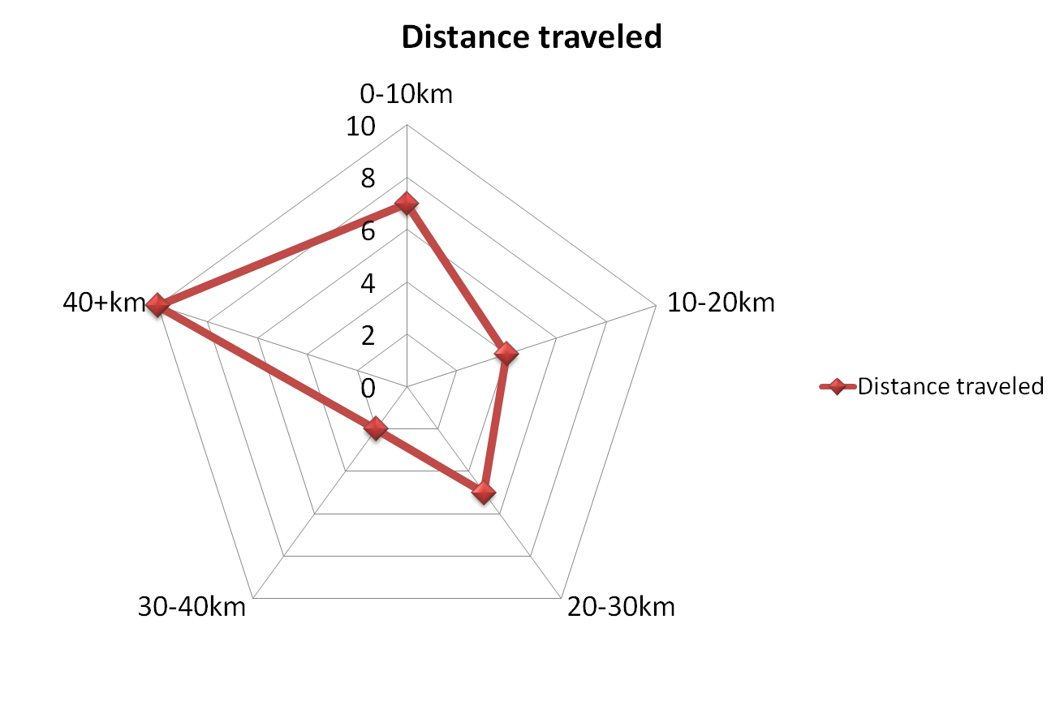
Where is your place of employment geographically located?

Slide 10
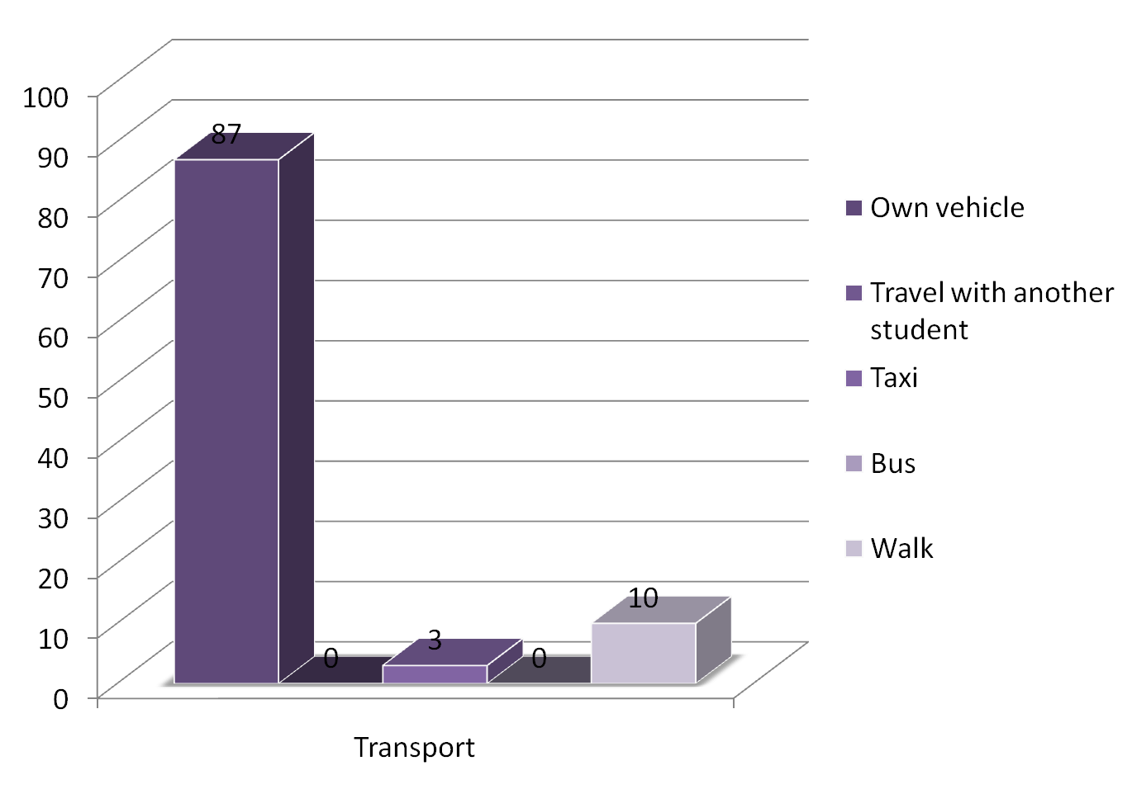
What mode of transport do you use to get to class?

Slide 11
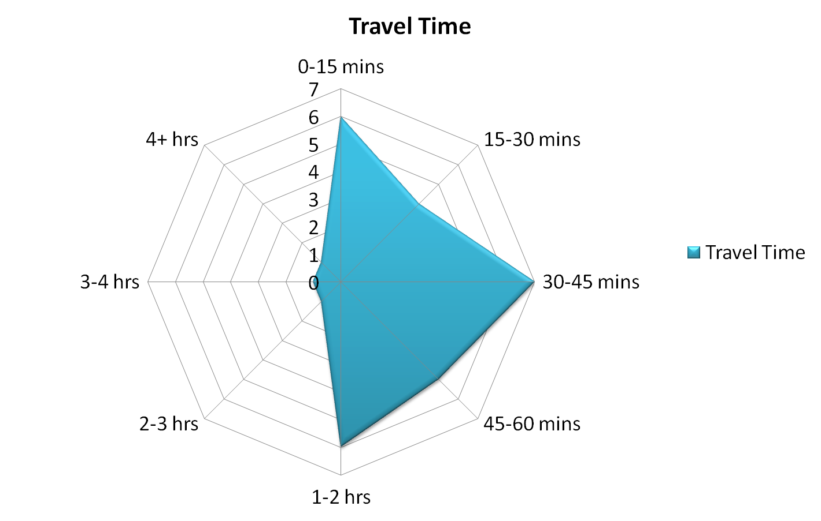
How long, on average does it take for you to travel to attend your lectures?

Slide 12
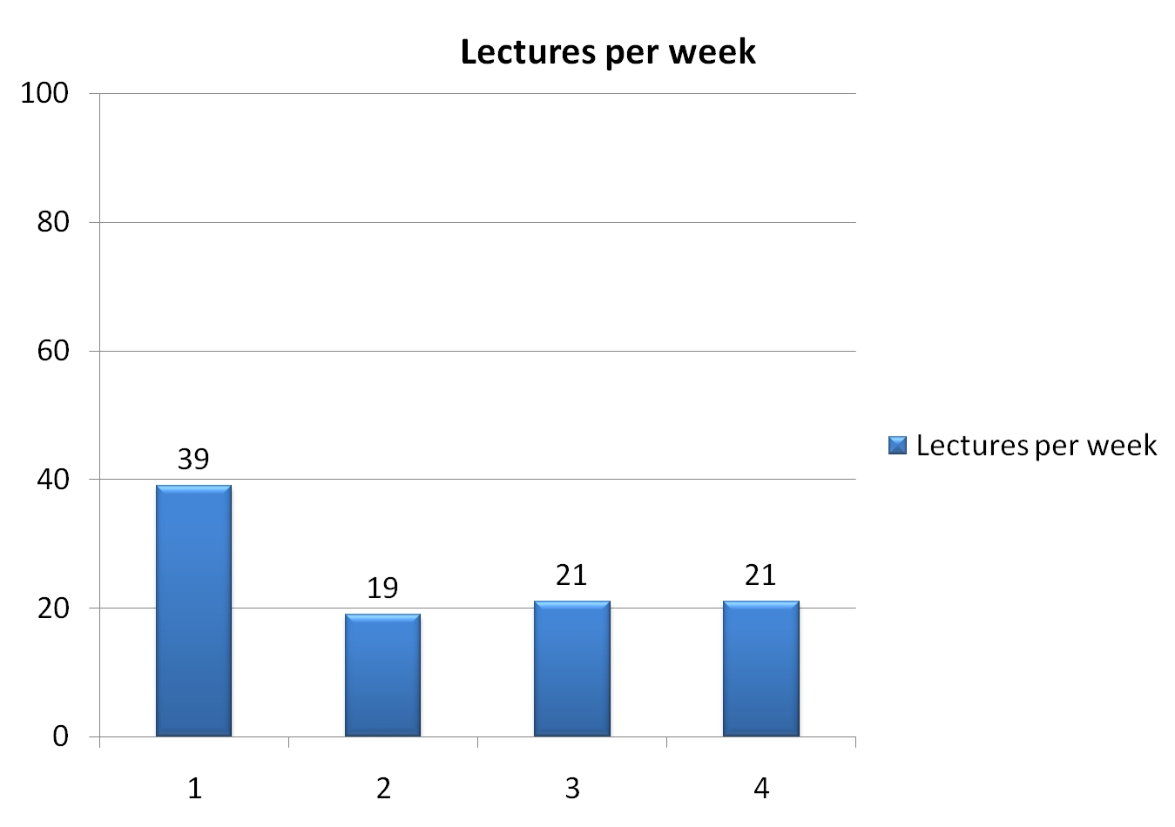
How many lectures are you required to attend every week?

Slide 13
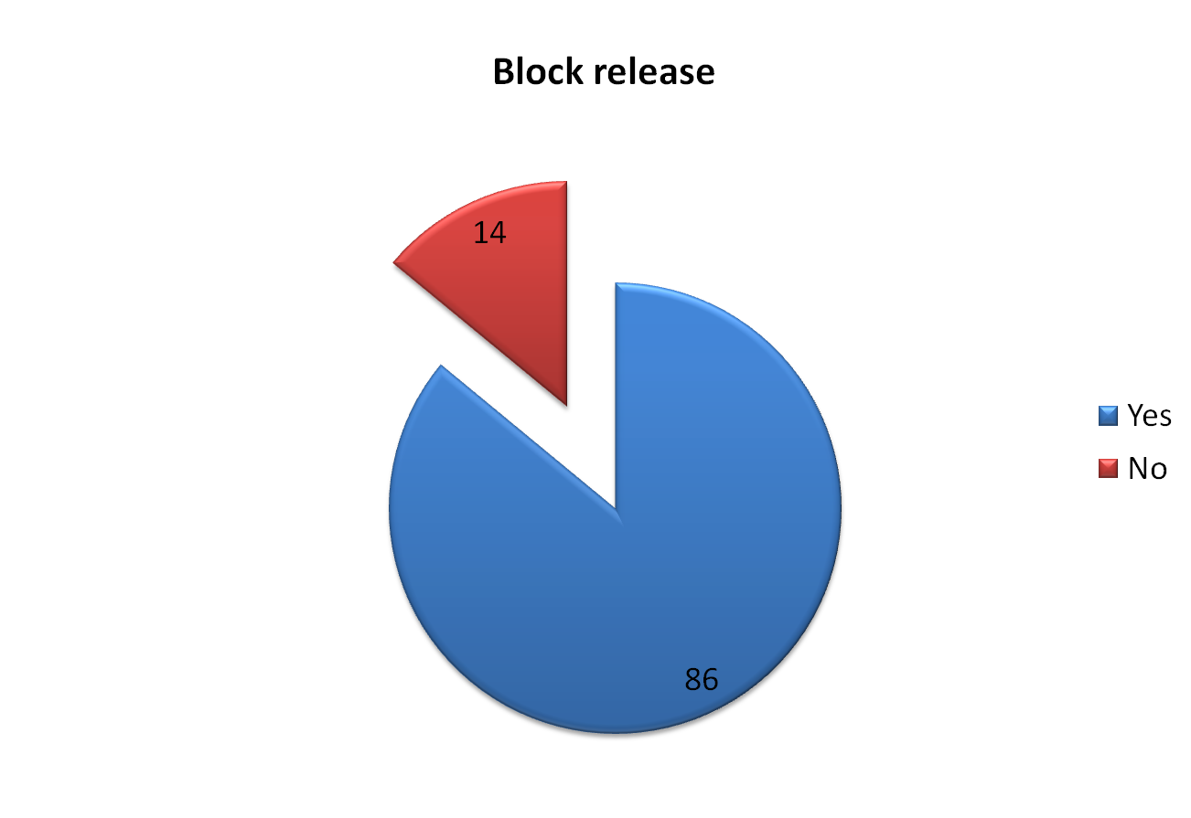
Would you be in favour of CEM offering its courses on a block release basis?

Slide 14
How many weeks per year would you be able to attend lectures on a block release basis?

Slide 15
Do you receive financial support from your employer with you studies?

Slide 16
If yes, what percentage of your studies is funded by your employer?

Slide 17
Do you have a contractual commitment to work back a certain amount of time with your employer? If so, what is the extent of this contractual commitment?

Slide 18
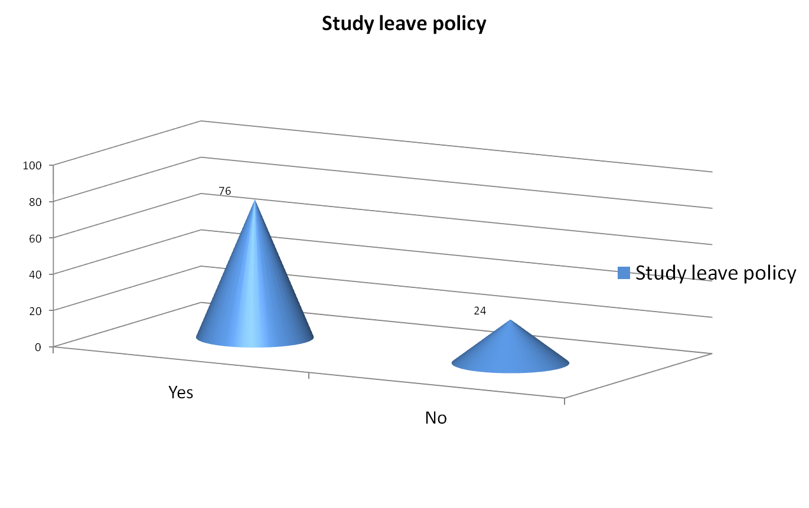
Does your employer have a policy regarding study leave? If so, what is this policy?

Slide 19
How did you hear about the current
academic programme that you are registered for?

Slide 20
Advantages and disadvantages of a attending lectures on a part-time basis
Advantages | Disadvantages
Able to work at the same time Ongoing learning Gain knowledge and experience at the same time | Traffic congestion Difficult to concentrate in the evenings Work commitments sometimes interfere with academic work

Slide 21
Advantages and disadvantages of attending lectures on a block release basis
Advantages | Disadvantages
Easier to commit to a block week No interference from work commitments Greater concentration on the topic being studied No gaps between lectures Assists with planning | Work commitments could affect attendance Too much information to absorb over a short space of time Could be very intense

Slide 22
Where to from here?
This preliminary study suggests that current students and are in favour of the postgraduate programme at WITS being offered on a block release basis.
This should allow CEM to attract students from other parts of Africa.
This does have implications for the curriculum as the curriculum is currently very inward focussed.
A survey of other programmes to establish best practice.
Employers to be surveyed and their commitment needs to be obtained.

Slide 23
Thank You
Questions?
Comments?
Suggestions?
To contact Graeme Jay
graeme@cpmd.co.za

