Slide 1

Real estate appraisal development during the II independency, the past, the present and the future
Kaarel Sahk, lecturer Estonian University of Life Sciences
European Real Estate Society 19th Annual Conference
13th-16th June 2012

Slide 2
Abstract
Real estate appraisal as a separate procedure had started after the declaration of the second independency. Preliminary all power was dedicated to the ownership reform and this approach makes appraisal procedure as a part of the reform. As a fact the procedure was not started from the valuation of properties so as three whales of reform, restitution, housing privatization and state property dispose as a goal of appraisal, collected all the activities. Beside the reform, a rising financial market started requires the valuation based on the other foundation than three whales. In this case the contemporary movement started while the IVS were published in Estonian in 1997. The second impulse arises from the initiated by Estonian Society of Real Estate Appraisers a procedure of professional certification. Simultaneously the changes in area based curricula and started membership in EU have played a significant role also. As a no isolated system, Estonian environment of real estate valuation bear the influences of international crisis. Last but not least impulse arise form the association with the Euro market that is representing the last approaches of the real estate appraisal as a procedure market dynamic. This short description gives a possibility to compare the local procedure with international one.
Keywords: real estate appraisal, ownership reform, foundation of procedure, impulses of development

Slide 3
State based stages of development
More observantly research of the situation makes clear that the contest of process we may followed hereby as a process that was built up and in this way is including the three basic stadiums and each of it are enough independent in their development and at the same time associated into one considering the hole development and morphology of them from the below of appraisal process:
  ex ante 1991,
  ex post 1991 or ex ante the 1st of May 2004 and
  ex post the 1st of May 2004.

Slide 4
How we get started?
It is remarkable, that bases of privatization were worked out before legal act (State property …)
Real estate appraisal procedure was started as a result of Ownership reform and based on it legal act “Legal act of Return and Compensation for Unlawfully Expropriated Property”
Legal Act of Dwelling privatization Law
Simultaneous forcing and development of a package of legal acts of Land reform

Slide 5
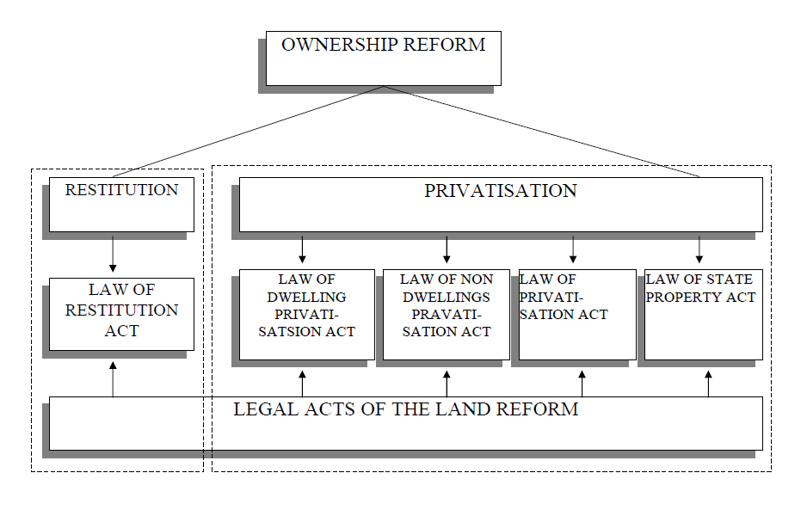
Legal foundation of real estate appraisal
Sahk, Kaarel . The Housing in Tartu.The situation and the solutions Housing and Environment. In: Report of the UN Regional Workshop on Housing and Environment: UN Regional Workshop on Housing and Environment, 22-23 November 1999, Vienna, Austria. Vienna, Austria: United Nations Centre for Human Settlements, 2000,

Slide 6
Who demand the procedure
Two basic parts of real estate market birth i.e first primary market participants
  Entitled subjects of ownership reform
  Obligated subjects of ownership reform
Three basic parts of real estate market development i.e emerged secondary market participants
  Entitled subjects of ownership reform
  Obligated subjects of ownership reform
  new property owners - property was acquired from previously named parties

Slide 7
Service and its providers
Service users
Servise providers
  Established real estate firms
  Local authorities
  Construction area experts
Finasncial institutions
Owners
Local authorities
State

Slide 8
Real estate landscape dynamics
ex ante 1991
i.e Soviet era
ex post 1991 - ex ante 2004.
II vabariik
ex post 05.2004
II vabariik - memebership of EU
REAL ESTATE LANDSCAPE
Civil code of E.S.S.R.
Land code of E.S.S.R.
Legal acts of II republic
Legal acts of II republic linked with EU legal space
Inventory Register
State Land Register
Inventory Register
Buildings Register
Land cadastre
Prperty Register
Building Register
Land Register
Property Register

Slide 9
Space of ownership reform and mass valuation

Slide 10
Definition of items followed
Appraisal. An expert opinion of the value of property, (noun) the act or process of estimating value, an estimate of value, (adjective) of or pertaining to appraising and related functions, e.g appraisal practice, appraisal service.
Valuation. The act or process of determining the value or worth of something. An assessment of the market value of property at a given point in time.

Slide 11
Definition of items followed
Assessment. An evaluation or a result of evaluation, made in order to determine the amount of tax to be paid by an individual; in particularly by an owner or occupier of the land or building
Assessment. A determiantion of the assessd value of real proeprty. An officialvaluation made for the purpose of a local tax that is to be levied on the basisi of assumed market value of property.

Slide 12
Foundation of valuation landscape
Three whales for development analyze
  Appraisal production quality development
  Appraisal service quality development
  Appraisers quality development

Slide 13
  Production quality development quality development
  Production quality development
  Movement from preliminary ordered requirements for appriasal report to use of international standards
  Implementation and development national standards
  Contemporay employment of international standards

Slide 14
  Service quality development
  Service quality development
  International recognition
  Certification of real estate companies
  Insurance of firms v.s insurance of appraisers
  International companies
  Audit of appraisers
  Etichs committee

Slide 15
  Appraisers quality development
  Appraisers quality development
  Certification of appraisers
  Requirements of education
  Step by step movement on the professional level
  LLL
  Audit of appraisers
  Etichs committee
  Accounting of market demand

Slide 16
Real estate appraisal life cycle
Premature independency 1991-1994
Start of acitivty 1995-1999
Professional development I stage 1999-2004
Professional development II stage 2004-2010
Contemporary movement since 2010

Slide 17
Appraiser’s qualification
Evaluation by Estonian Association of Appraisers in co-operation Chamber of Commerce and Estonian Banking Association -1999
Professional certification with Estonian Qualification Authority- 2002
  Regulated by Professions Act
  Supervised by Professional Council
  Certificates registered in Register of Professions
  Founded on professional standards
  Managed by Awarding body in connection with Regulation of awarding of profession

Slide 18
EU influence
The movement towards European standards together with the accession introduces the need of the separate approach of historical real estate i.e. properties and their historicity as a narrative story or complexity of semiotic signs, in the contest of the four driving forces of EU - the four basic freedoms of it, signed by members of EU in The Maastricht Treaty:
Movement of goods,
Movement of capital,
Movement of services and
Movement of labour

Slide 19
EU influence. Vol 2
Beside with the EU freedoms influence, therefore exist a influence of changes of real estate market
  Diversification of objects submitted to appraisal procedure
  Concentration of business, e.g appraisal business
  Permanent movement form demand based market to supply based market

Slide 20
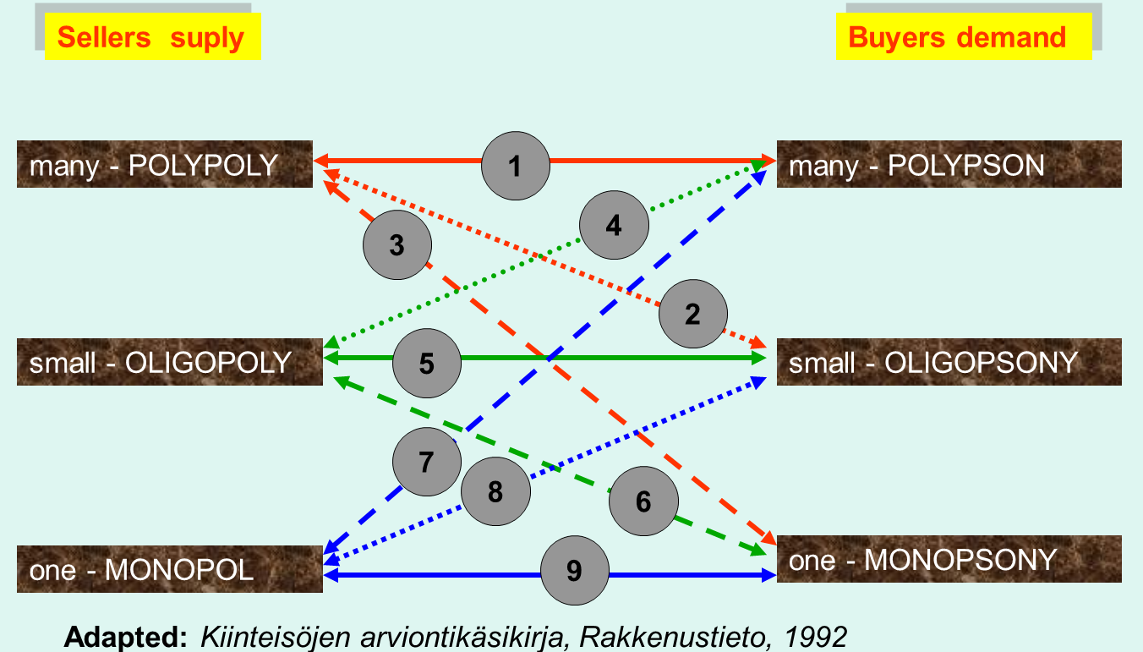
Real estate market constellation influencing appraisal procedure

Slide 22
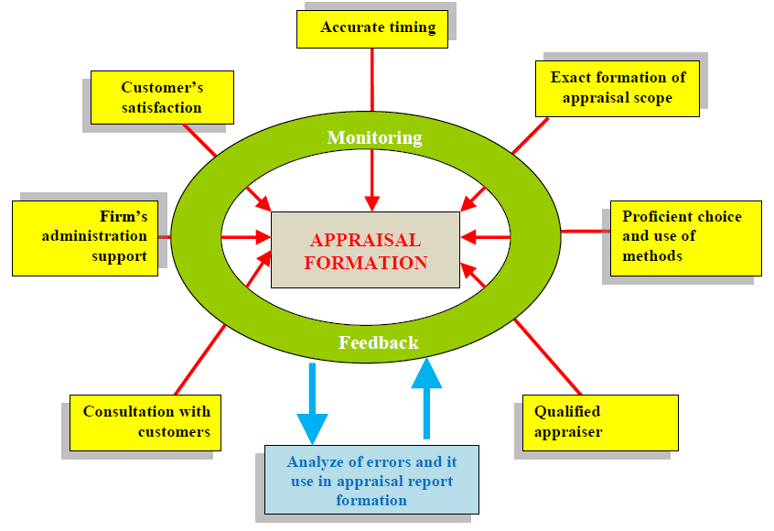
Appraisal quality formation

Slide 23
Methods that are employed
How we started
Were we go
Approaches of valuation & Methods of valuation
Cost approach
Income approach
Sales comparison approach
Approaches of valuation & Methods of valuation
The capital comparison;
The investment method;
The depreciated replacement cost method;
The residual method and
The profits method
French Nick; Gabrielli Laura (2007) Market value and depreciated replacement cost: contradictory or complementary? Journal of Property Investment & Finance, 5(25): 515-524

Slide 24
Professional body
Standardization and legal authorities
Certification authorities
Real estate appraisal space
Real estate appraiser’s quality
Real estate appraisal production quality
Real estate appraisal service quality
Area based EU legislation, International standards, EN & ISO
EVS EN-45011, -45012,
-45013
IVS, EVS, IAS
IFRS
ISO 9001
ISO 14001
ISO 18001
Overall EU legislation, Euro codes (EN), International standards (ISO)

Slide 25
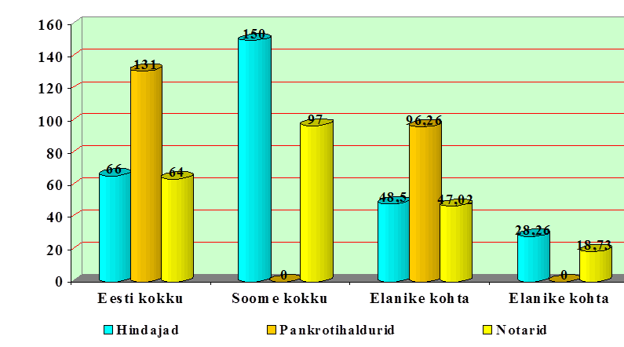
Number of market professionals Estonia v.s Finland
Estonia Finland Estonia per capita Finland per capita
Appraisers#Assignee in bankruptcy#Notary
Addapted Pomerleano Michael (2002) Back to the Basics: Critical Financial Sector Professions Required in the Aftermath of an Asset Bubble, The Appraisal Journal, April 2002, pp 173-181

Slide 26
Time line & basic markers of real estate appraisal development

Slide 27
Problems (1)
Multiplicity of recognition of professionals
  Activity based – Ministry of Economics
  Profession based – Register of professions
  State licensed – Land assessment and valuation
  State authorization – Estonian Forensic Science Institute
  State licensed – environment impact assessment

Slide 28
Problems (2)
Activity of intended users - owners approach
Shortage of co-operation with Council of Auditors, Courts, Executive sales officers
Manners of international banks – movement to wards more developed inside valuation
Utility rate of market
National migration changes

Slide 29
Questionary (poll)
Actual, takeing into account questionary is linked with MSc thesis of students and will be attached to future paper.

Slide 30
Literature
Kolbre, E; Kask, K:REAL ESTATE VALUATION IN ESTONIA AND ITS RECONCILIATION WITH EUROPEAN STANDARDS
Brown, J. R., Private Real Estate Investment. Data Analysis and Decision Making, Elsevier, Amsterdam, Boston, Heidelberg, London, New York, Oxford, Paris, San Diego, San Francisco, Singapore, Sidney, Tokyo, 2005
Adair, A.; Downie, M. L.; McGreal, S.; Vos, G. European Valuation Practice: Theory and Tecniques. E & FN Spon, 1996
Pomerleano Michael (2002) Back to the Basics: Critical Financial Sector Professions Required in the Aftermath of an Asset Bubble, The Appraisal Journal, April 2002, pp 173-181

Slide 31
Questions please!

Slide 32
Thank you!

Slide 33
Author’s additional information:
https://www.etis.ee/Portaal/isikuCV.aspx?LastNameFirstLetter=S&PersonVID=43875&lang=en&FromUrl0=isikud.aspx
E-mail address
kaarel.sahk@emu.ee
Mail address
Kreutzwaldi 5, 51014
Tartu
Estonia

