Slide 1

Owner-occupiers risks and foreclosures
- over three downturns at the Danish housing market since 1979 the ERES Conference, Edinburgh, June 13-16, 2012.
Jens Lunde
Associate Professor
Department of Finance, Copenhagen Business School

Slide 2
Access to raise a mortgage for owner-occupiers
Overview:
The mortgage bank estimate the property’s market value, at sale normally the price.
Loan-to-value: 80 % (the same for most other property types).
Max term: 30 years (except: if < 70 % LTV, then no max)
Equity withdrawal possible.
Different loan types: fixed interest rate annuity mortgage (FRM), adjustable interest rate mortgage (ARM), ARM with cap, interest only mortgages (interest only period max 10 years).

Slide 3
”Denmark: world champion in household debt” (Muellbauer, 2007)
Gross household debt in per cent of disposable incomes. 1995, 2000 and 2009. Source: OECD.

Slide 4
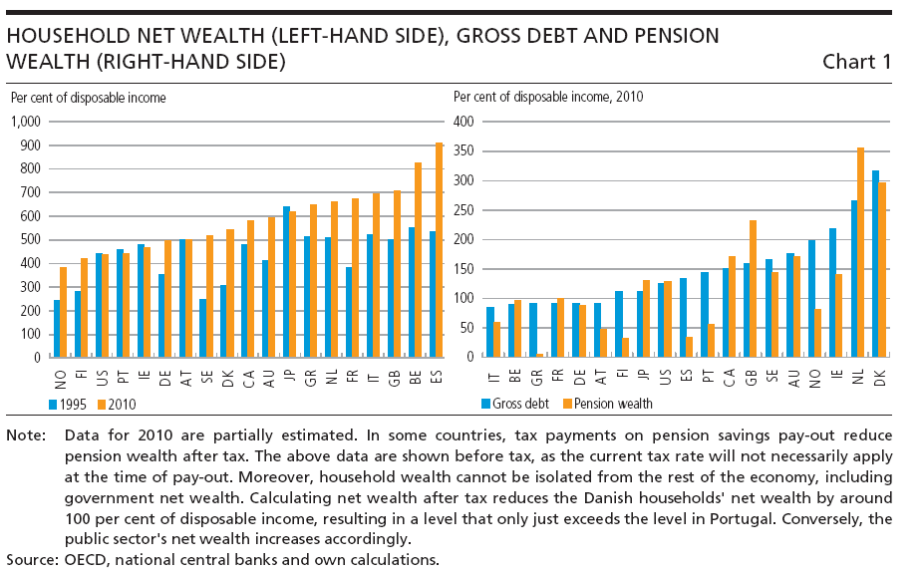
… the central bank’s response
(Monetary Review, 4. quarter 2011)

Slide 5
The 20 % of the owner-occupiers with highest mortgage debt
Owner-occupiers (exclusive self-employed) divided into deciles after age and after size of mortgage debt in percent of gross family income, 8th decile, 1987-2009.

Slide 6
Also higher mortgage debt at the median ratios
Owner-occupiers (exclusive self-employed) divided into deciles after age and after size of mortgage debt in percent of gross family income, 5th decile, 1987-2009.

Slide 7
Owner-occupiers’ risk
Risk for negative equity
Liquidity risk
Market risk – idiosyncratic risk
Property price risk – interest rate risk – other market risk
Correlation risk
  Negative equity and liquidity problems appear to a large number of debtors at the same time.

Slide 8
Special Danish risk features at mortgages
At interest rate increases:
ARM: payments increases – debt is (nearly) unchanged
FRM: payments unchanged – debt is falling fast
Interest increase might lead to falling house prices
Then
if ARM: falling equity
if FRM: somehow unchanged equity
And reverse at falling interest rates
Except for the call option in FRM

Slide 9
Foreclosure
A foreclosure is the final solution
  when a borrower is unable to pay his promised debt services on his loan,
  and when he is in negative equity (“under water”)
A well-established set of legal rules exists.
An auction – often with quite few bidders, among them the creditors.
Still after the foreclosure: the debtor owes the not covered debt
  and the high costs at the foreclosure process are added.
A foreclosure remains as a lifelong economic burden for the foreclosure hidden person and family.
Ending up in foreclosure is a dishonour.
To avoid moral hazard: The existence of a foreclosure system is a presumption for an efficient mortgage system with high loan-to-values (LTV).

Slide 10
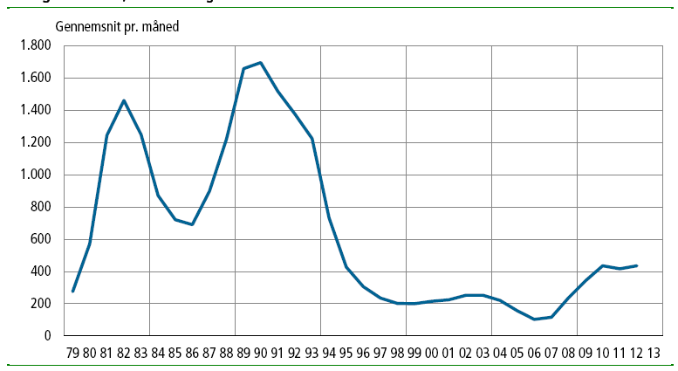
The monthly Statistic Denmark news
May 2012

Slide 11
Number of foreclosures, two sources:
1. Statistic Denmark: announced foreclosures
2. Domstolsstyrelsen: realized foreclosures
 | announced foreclosures | realized foreclosures
1980 | 6846 | 6066
1981 | 14923 | 13816
1982 | 17516 | 16651
1983 | 14977 | 15256
1984 | 10444 | 8000
1990 | 20339 | 14262
1991 | 18188 | 12040
1992 | 16519 | 10646
1993 | 14693 | 10671
1994 | 8788 | 6377
2006 | 1231 | 689
2009 | 4140 | 4355
2010 | 5222 | 5305
2011 | 5025 | 4775

Slide 12
Foreclosures 1979 – 2011.
(Annual data)

Slide 13
Realized foreclosures as per cent of the year’s announced foreclosure.

Slide 14
Frequencies
2011: average rate for announced foreclosure : 0.21 % of the stock of houses.
2011: average rate for announced foreclosure: 7.45 % of the number of sold properties (all types).
1990: average rate for announced foreclosures: 16.7 % of the number of sold properties (all types).
1990: average rate for realized foreclosure : 11.7 % of the number of sold properties (all types).
And other frequencies will be calculated
Foreclosure frequencies might be part of calculated risk premiums for mortgage and bank loans.

Slide 15
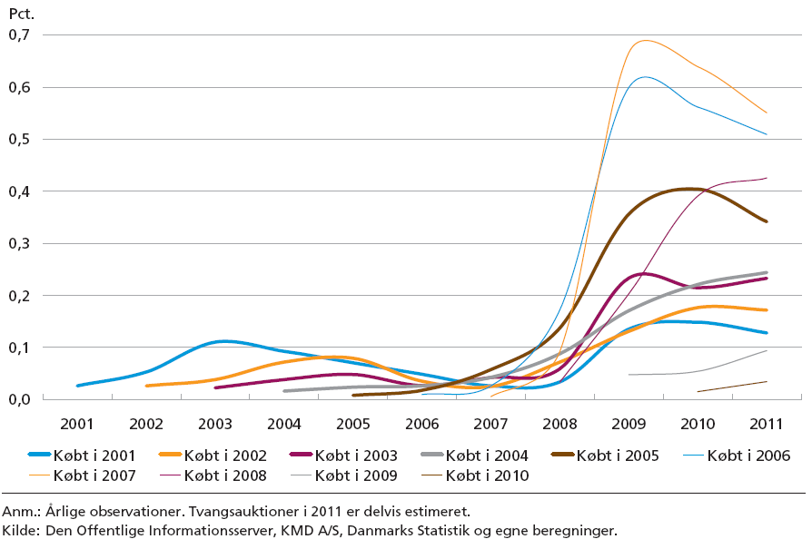
Foreclosures in per cent of number of sold houses and flats in the purchase year.
Source: ”Financial Stability 2012”.

Slide 16
Natural rates of foreclosure?
Geoff Meen: the natural rate of possessions in UK is now higher than in the 1970s or early 1980s. Among the reasons is the significant increase in the mortgage debt-to-income ratios as partly due to the mortgage market liberalisation in the 1980s. (Meen, 2008, pp. 2771-3).
In Denmark, possibly a higher rate can be found in average but might be due to the mass foreclosure periods.

Slide 17
Also it has been worse before – 2012
- mass foreclosures often a part of financial crisis?
Green and Wachter: even though home mortgages had very low loan-to-value ratios of 50 percent, the decline in property prices by 50 percent in the early 1930s made borrowers default: “A wave of foreclosures resulted – typically 250,000 per year between 1931 and 1935. At the worst of the Depression, nearly 10 percent of houses were in foreclosure.” (Green and Wachter, 2005, pp. 94-95).
Drop in world market prices on corn in the beginning of the 1820s resulted in property price drops and foreclosures for farms… The property crisis was rather deep as seen of the foreclosure announcements in the newspapers from that age; many properties did not find a buyer before the 6.th or 7.th announced foreclosure. (E.Olsen, 1962, p. 47; Svend Aage Hansen, 1968, pp. 168-170).

Slide 18
The cycles in real house prices and in number of (all) foreclosures.

Slide 19
On the edge at a new flood of foreclosures?
Real housing prices are falling.
The technical insolvency has increased (see below)
The rescue operations until 2012:
  The low interest rate regime (since the autumn 2008),
  the reduced income taxation as part of the state budget deficit
  the owners remortgaging to adjustable interest rate and to interest-only mortgages (see below).
Relatively few Danish households in arrears

Slide 20
The 20 per cent most indebted owner-occupiers – compared to housing wealth.1987-2009.
Owner-occupiers (excluding the self-employed) divided into deciles by size of net liabilities as a per cent of housing wealth in the 8th decile.

Slide 21
The 20 per cent most indebted owner-occupiers – compared to gross household income. 1987-2009.
Owner-occupiers (excluding the self-employed) divided into deciles by size of net liabilities as a per cent of gross household income in the 8th decile.

Slide 22
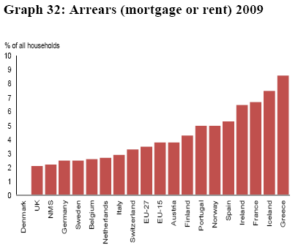
Few households with liquidity (payment) difficulties:
Extraordinary low number of arrears in Denmark.
Source: EU Article 5 analysis. 30.5.2012.

Slide 23
The 20 per cent of the owner-occupiers with highest net interest expenditure-to- gross household income. 1987-2009.
Owner-occupiers (excluding the self-employed) divided into deciles by size of net interest expenditures as a per cent of gross household income in the 8th decile.

Slide 24
Special risk factors for a new flood of foreclosures.
Real incomes are falling.
Risk for increasing unemployment.
Real housing prices have fallen – and are expected to continue to fall.
The technical insolvency has increased and nothing indicate any improvement since 2009.
The part of ARM mortgage have increased
  => reduced debt services
  => increased payment risk
The high interest-only mortgage part contain a special remortgaging risk from 2013 on.
  significantly increased debt services
  remortgaging problematic

Slide 25
Adjustable interest rate mortgages as percentage of all outstanding mortgage loans.
Per cent | January 2003 | January 2004 | January 2005 | January 2006 | January 2007 | January 2008 | January 2009 | January 2010 | January 2011 | March 2012
Agriculture | 37.0 | 43.9 | 51.1 | 58.3 | 58.7 | 71.8 | 78.1 | 83.4 | 86.8 | 88.5
Owner-occupied dwellings | 28.0 | 36.2 | 46.0 | 49.7 | 46.8 | 45.3 | 45.9 | 59.1 | 65.0 | 68.6
All outstanding mortgage loans | 28.9 | 36.9 | 45.3 | 49.2 | 47.4 | 52.2 | 55.3 | 65.1 | 69.9 | 72.9

Slide 26
Interest-only loans as percentage of all outstanding mortgages. 2003:4 – 2012:1.

Slide 27
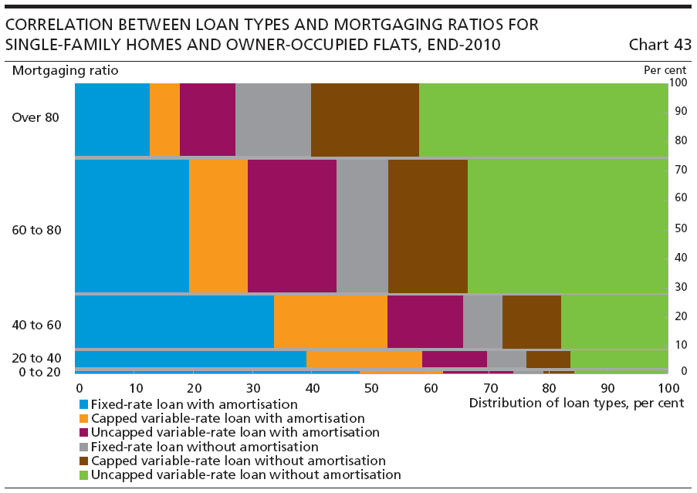
From Danmarks Nationalbank:
Financial Stability 2011.
(Not repeated in Financial Stability 2012)

